Slide 1
THE LORD’S MOVE IN LAOS
主在寮國的行動
ຄຳແກະນຳຂອງລາວ ໃນລມເອ

Slide 2
Introduction 介紹
1. Background, present situation and development 背景與發展現況
2. Coordination 配搭
3. Perfecting of the saints 成全聖徒
4. Translation work 翻譯工作
5. Propagation coordinated by the church in Taichung 台中召會赴寮開展

Slide 3
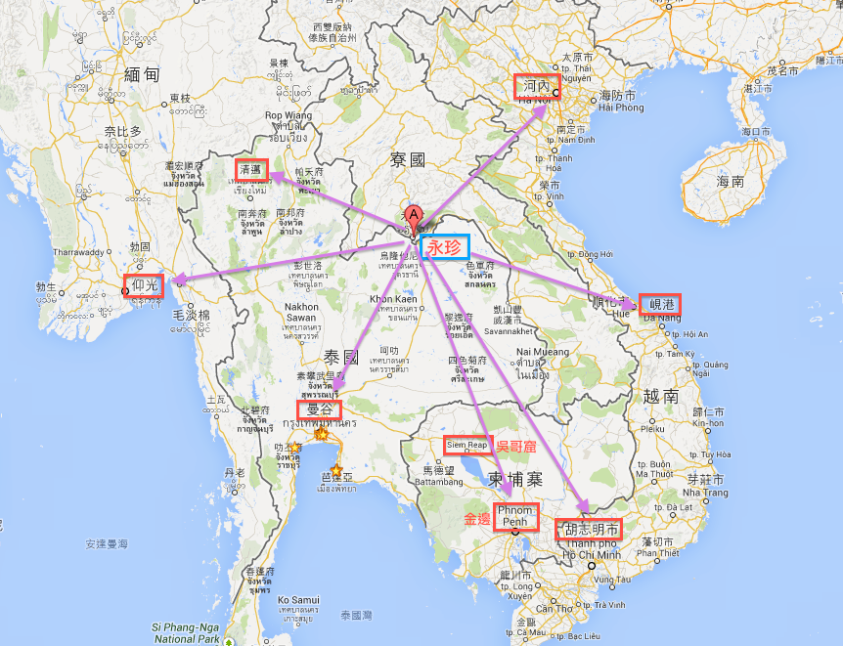
Located in the Geographical Center of Indochina 位處中南半島地理中心
昆明

Slide 4
History 開展歷程
1. Some saints from various countries came for propagation before 2019
2009年前有些各國聖徒來此開展
2. LMA serving ones came in 2010
2010年LMA開始有服事配搭
3. Translation work started in 2012
2012年嘗試佬文文字翻譯工作

Slide 5
History 開展歷程
4. More overseas saints joined the coordination in the capital city Vientiane and Pakse in 2012
2012年更多海外聖徒陸續加入配搭開拓 首都萬榮與巴色
5. Full-timers from Taichung joined the propagation to strengthen the move in different areas in the capital in 2015
2015年台中有全時間者加入工作，加強開拓首都各區．

Slide 6
Present situation 現況簡介
1. Even with the reduction of full-timers, currently there are 2 localities and 3 districts meetings under our care
2019年因全時間服事者減少，聚會數暫時維持五處照顧
2. There are two Lao-speaing districts and one Chinese-speaking district at the work center Vientiane
以首都萬象為主要服事地，有兩處佬語區與一處華語區
3. Church service are gradually being established
正逐步幫助召會建立有秩有序中.

Slide 7
Present situation 現況簡介
4. The saints are being helped to practice begetting, nourishing, teaching and building up in the church life. Currently we are strengthening the practice of nourishing in home meetings
正逐步幫助聖徒過生養教見的召會生活中，目前福音新生暫時可以，故盡力幫助家聚會餵養的實行.
5. The translation work is going on. Due to the limited resources, only the HWMR and the shepherding materials are being translated
佬文翻譯工作持續進行，但限於能力只能專注於召會當前的追求材料，如晨興聖言與初信牧養上.

Slide 8
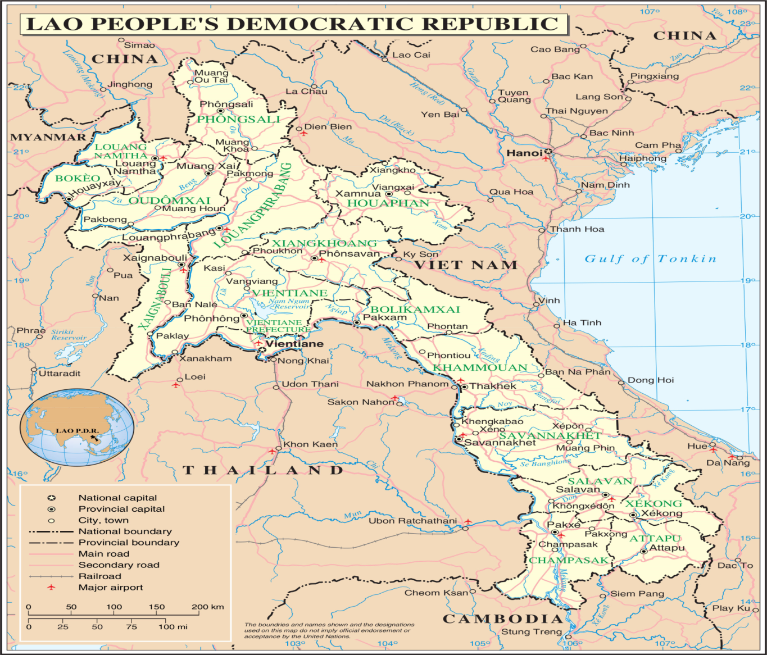
2 churches(blue) and 4 district meetings
現共有2處召會，有4處擘餅點
Vangviang
2. 萬榮
Veintein
1.
Pakse
3. 巴色

Slide 9
The all List of LGHN in 2018
CHURCH
LORD’S TABLE
GROUP
MEETING
HOME MEETING
NEW BELIEVERS
1.Vientiane
62
43
44
57
2.Vangyiang
18
6
10
15
3.Pakse
3
0
0
0
Total
83
49
54
72

Slide 10
Coordination 配搭
Saints from four countries coordinated together
來自四個國家的聖徒一同配搭

Slide 11
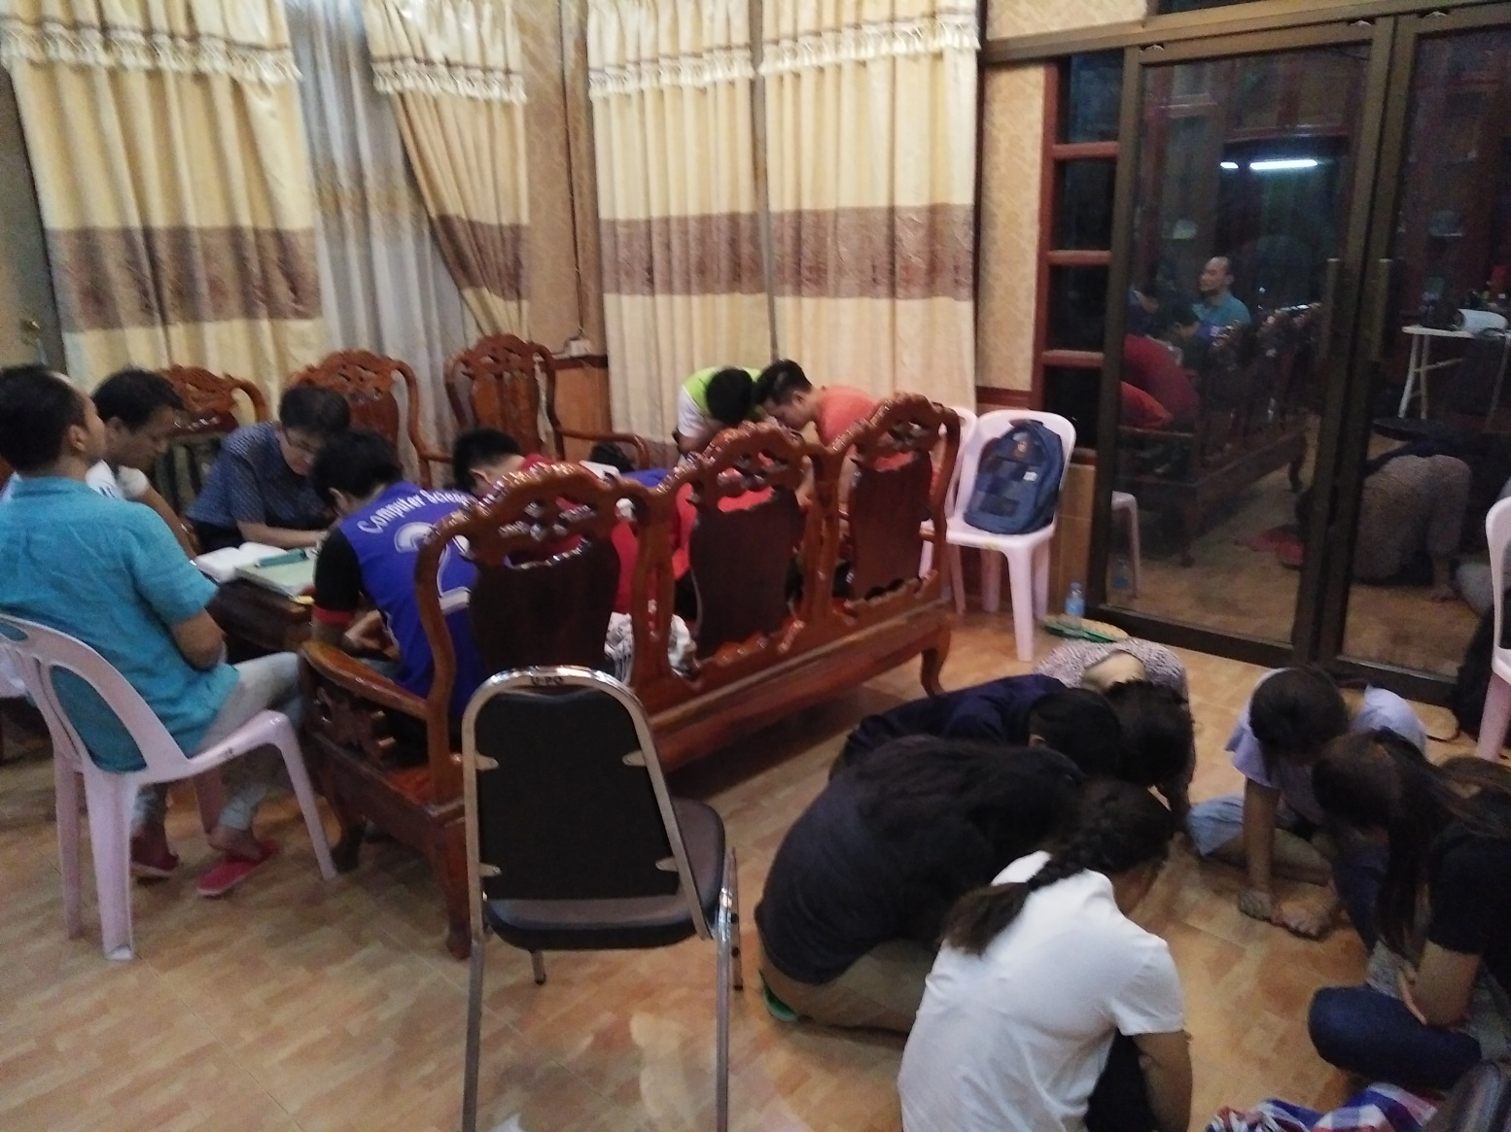
Combined service prayer
集中事奉禱告

Slide 12
Perfecting 成全
Although new ones got baptized every week, not many remained. Therefore we invited saints from Taichung and Thailand to help us in our perfecting of shepherds.
基於聖徒受浸已有週週得人果效，唯新人存留率不高，確定五月份邀請台中和泰國前來有成全牧養者的特會．

Slide 13
Perfecting 成全
The perfecting focus was on God’s eternal economy, knowing the church and shepherding. Around 50 saints attended
講神永遠的經綸，認識召會與牧養新 人．約有50多位聖徒參加.
More saints started to pursue the HWMR
起來追求晨興聖言的人數明顯多起來．

Slide 14
Perfecting 成全
The first 16 lessons of the Shepherding Materials were translated. The saints pursue this material on Tuesday prayer meetings and were helped to shepherd the new ones. As a result more saints started to prophesy in the meetings
接著翻譯了佬文初信牧養(一)神高品福音16課．聖徒們用週二晚上的禱告聚會，一同研讀這份教材，學習牧養新聖徒．召會聚會申言逐漸明顯的活絡起來．

Slide 15
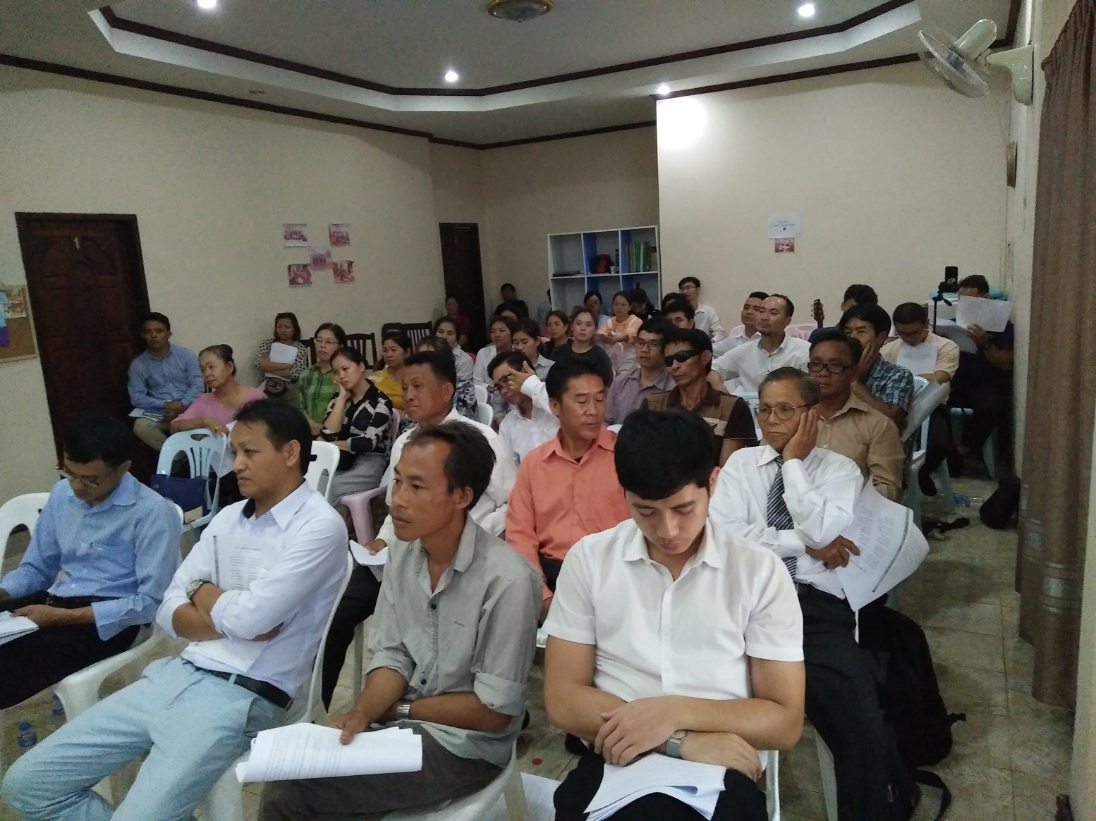
Conference for shepherds in May
五月成全牧養者特會

Slide 16
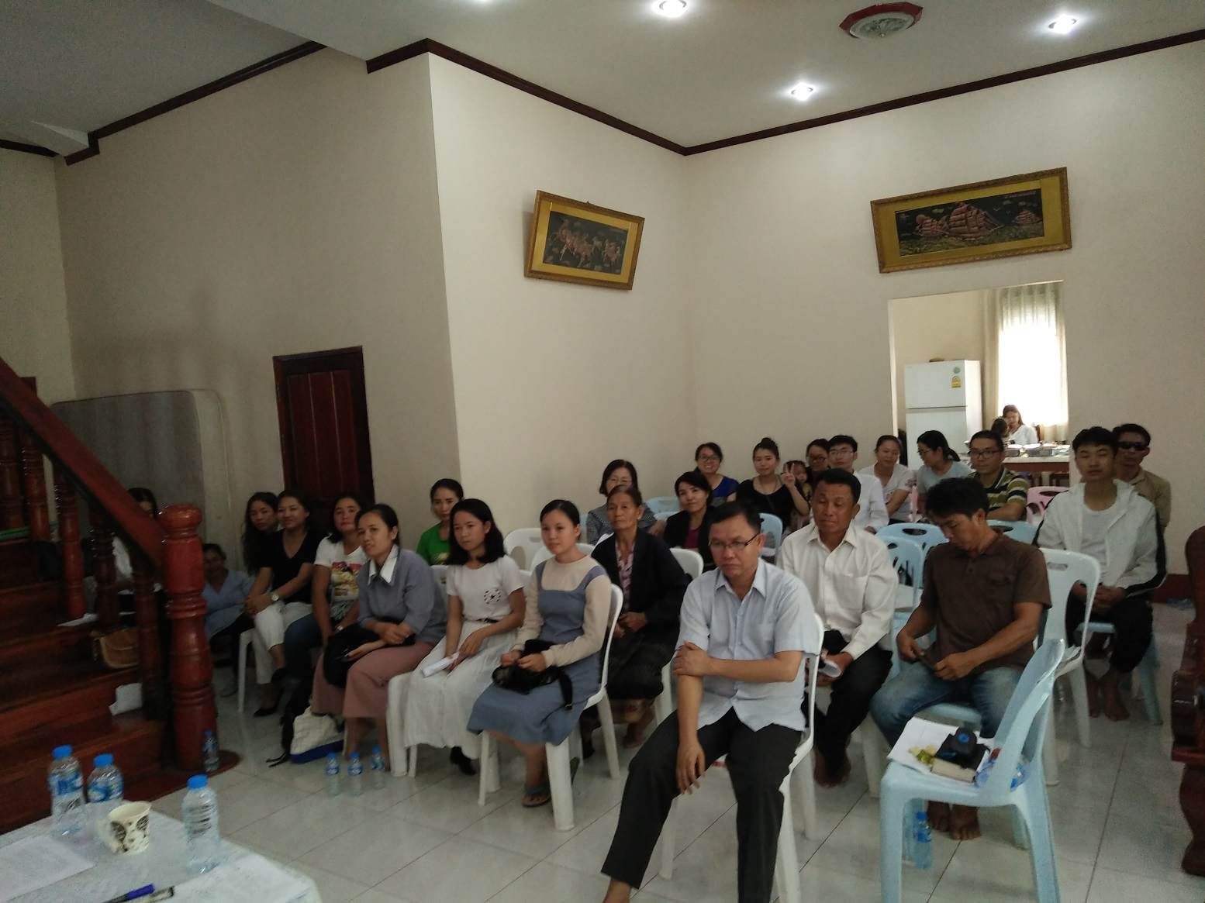
Conference for shepherds in May
五月成全牧養者特會

Slide 17
Translation work 翻譯工作
There is a great and desperate need for translation work
翻譯是這裡極大且迫切的需要．
1)the HWMR; 2)The first 16 lessons of the Shepherding Materials and 3)the footnotes of the NT Recovery Verison
1.召會晨興聖言的追求材料. 2.初信牧養(一)神高品福音16課的餵養材料. 3.恢復本新約聖經的註解.

Slide 18
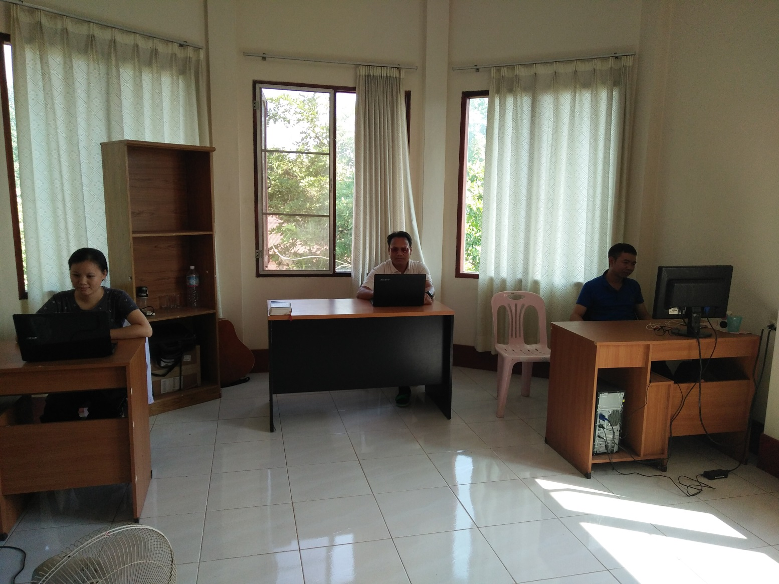
Literature work serving ones
文字工作者

Slide 19
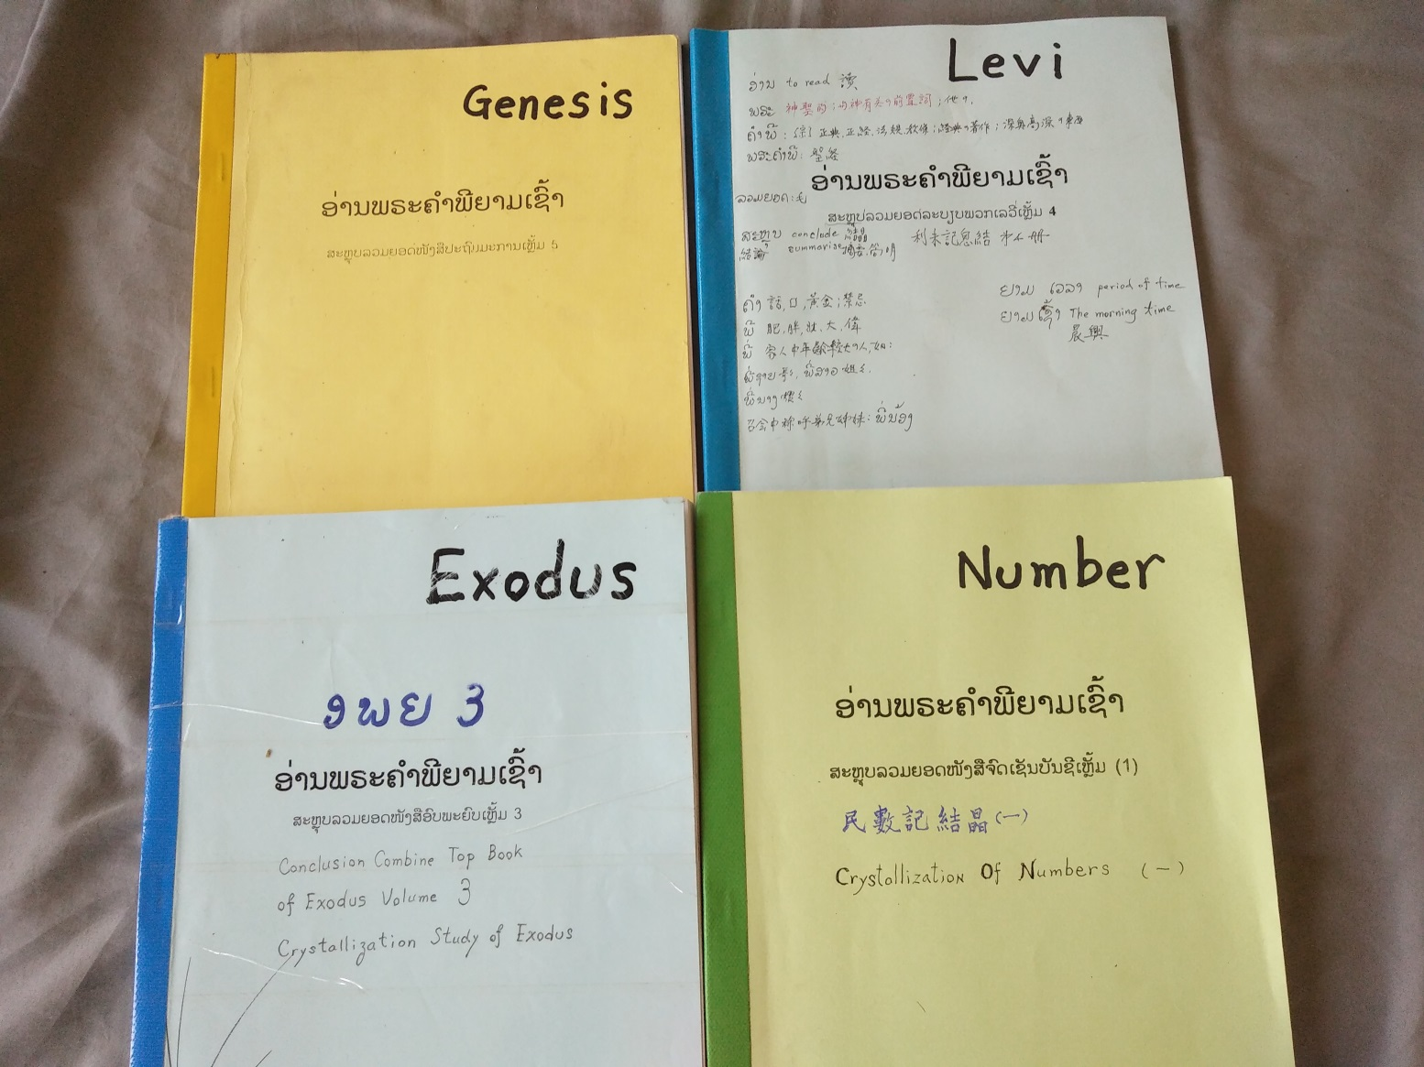
Literature work 文字工作

Slide 20
Propagation coordinated by the church in Taichung 台中召會赴寮開展
13 saints came to visit in January and 10 saints came in September
今年一月來13位,九月來10位
In January the saints gained 8 new ones; five of them remained and brought other new ones to salvation
一月份主給他們8個果子，有5個還常存著，還帶新人得救.

Slide 21
Propagation coordinated by the church in Taichung 台中召會赴寮開展
The saints’ visit in September were to perfect us on home meetings; they accompanied the local saints to care for the new believers and gained another 6 new ones.
九月份專專為著作家聚會，陪帶著本地聖徒照顧新聖徒，結果也得著６位親友.
7 serving saints came from Thailand for a month and gained 17 new ones
泰國７位來留一個月，共得果子17位.

Slide 22
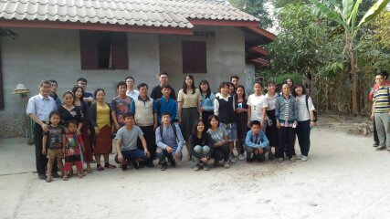
College saints visited Laos in January 一月大學生來訪相調

Slide 23
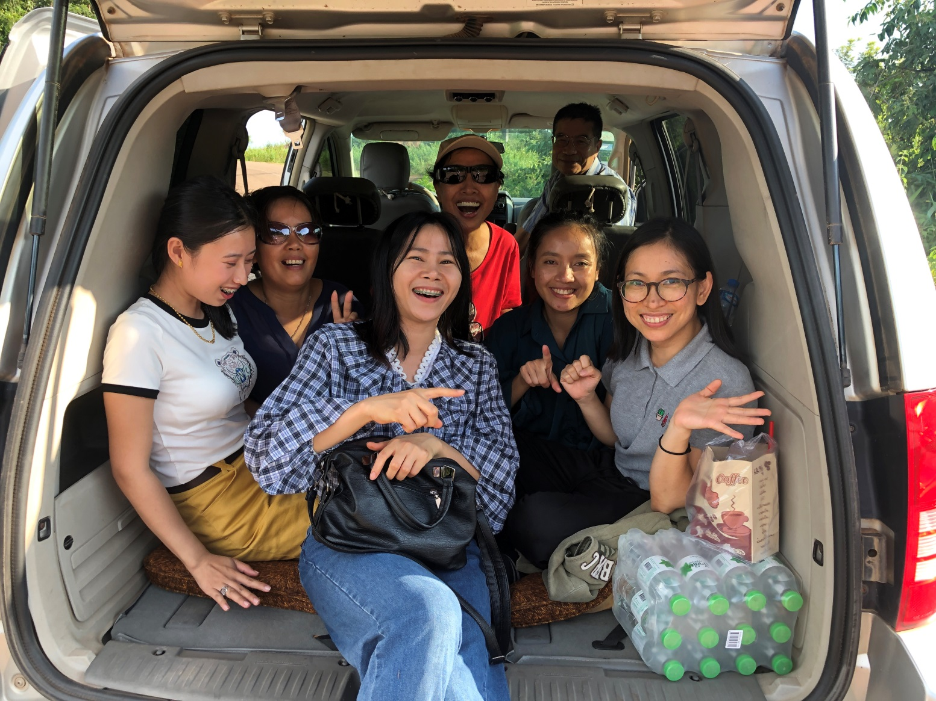
Shepherding team came in September 九月全面餵養開展

Slide 24
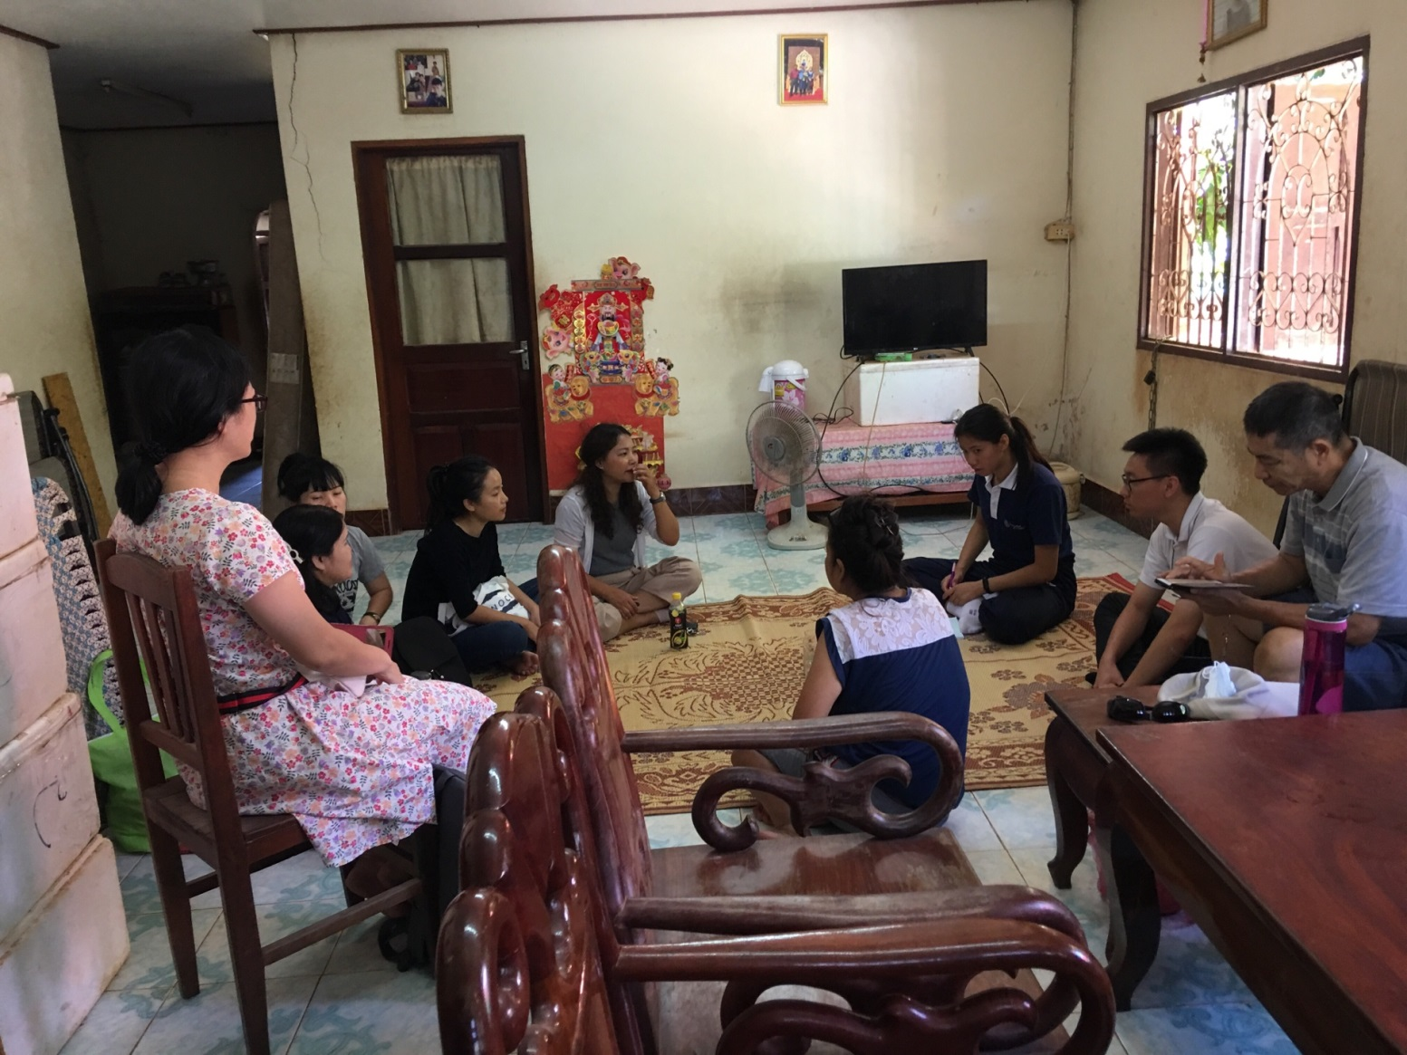
Shepherding in the home meetings
家聚會的牧養

Slide 25
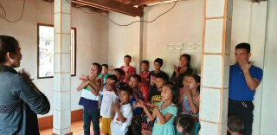
Shepherding for children
對兒童的牧養

Slide 26
Conclusion 總結
1 Coordination of saints from different countries are being established
跨國際的服事團運作逐漸上路
2 The Lao saints started to handle the translation work
寮國本地聖徒開始接手翻譯服事.
3 In the matter of preaching the gospel the Lao saints gained much fruit
寮國聖徒在福音產生新果子上表現優異.
4 Through the perfecting of serving ones, the shepherding work was much strengthened
藉成全中幹加強對新得救者的餵養工作

Slide 27
Prayer items 代禱事項
For the full-timers’ pursuing and service to be strengthened
加強全時間之追求與事奉
For the brother serving group and sister pursuing group in the church to be strengthened
堅固召會弟兄服事奉團與姊妹追求團.
To strengthen the translation work
加強文字翻譯工作
To strengthen the administration of the church
加強召會的治理
To to other potential cities
擴展至其他有潛力的城市

