Slide 1
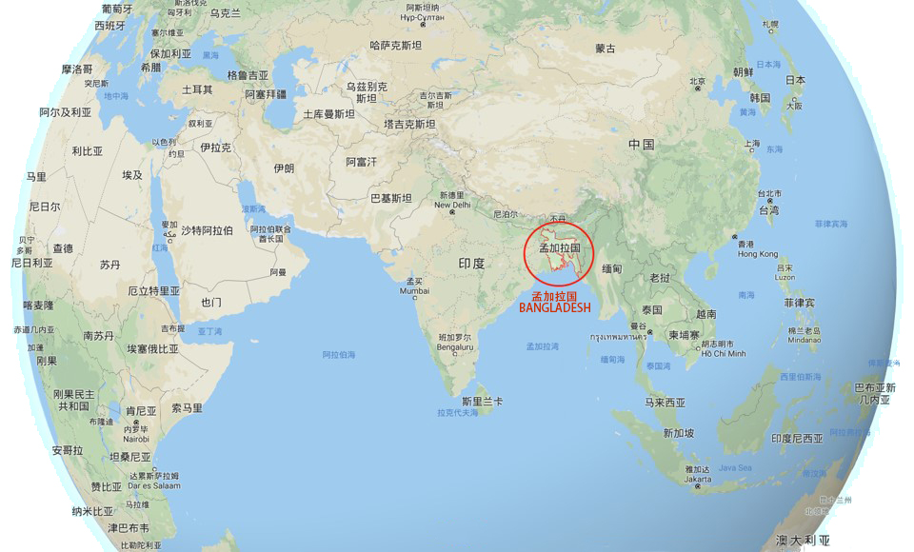
Lord‘s Move in Bangladesh
主在孟加拉国的行动

Slide 2
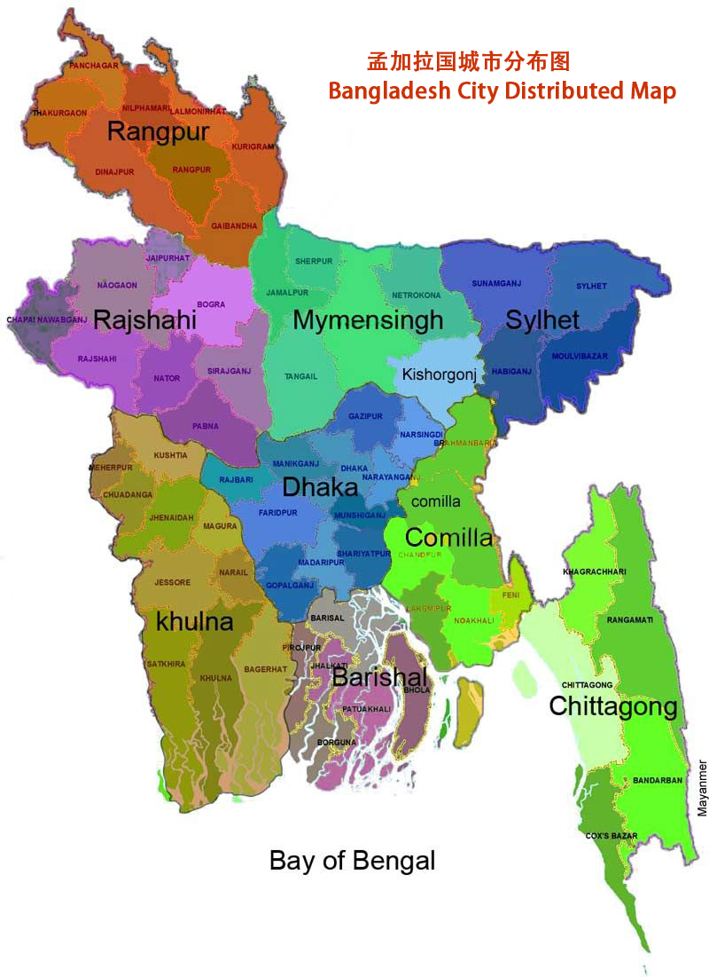
Land And Population in Bangladesh 孟加拉国的土地与人口
Land Scale 土地: 147,570 km²
Population 人口 : 163 Millions.
Religion 宗教比列 :
Muslim 穆斯林 87%
Hinduism 印度教 12%
Christianity基督教 0.5%
Buddhism 佛 教 0.5%

Slide 3
God’s ordained-way practice in Dhaka 神命定之路-达卡-19年4月-8月
Project 项目 | Average Member 平均人数 | Apr-19 | May-19 | Jun-19 | Jul-19 | Aug-19
Lord's Table Meeting 主日聚会 | Arrived 到会人数 | 20 | 21 | 20 | 19 | 19
 | Goal 目标人数 | 30 | 30 | 30 | 30 | 30
 | New Ones 新进人数 | 0 | 0 | 5 | 0 | 0
Group 排聚会 | Arrived 到会人数 | 1/3 | 1/4 | 1/4 | 1/5 | 1/5
 | Goal 目标人数 | 5/ | 5/ | 5/ | 5/ | 5/
Homemeeting 家聚会 | Shephred Family 牧养家庭 | 9 | 11 | 10 | 12 | 10
 | Shephred Mumber 牧养人数 | 21 | 29 | 27 | 25 | 21
 | Goal 目标人数 | 20/ | 20/ | 20/ | 20/ | 20/
Propagation 传福音 | Member 人数 | 0 | 6 | 7 | 6 | 5
 | Time 时间 | Tuesday 6-8pm | Tuesday 6-8pm | Tuesday 6-8pm | Tuesday 6-8pm | Tuesday 6-8pm
Baptize 受浸 | Baptized 受浸 | 0 | 3 | 2 | 0 | 0
 | Goal(total) 目标总数 | 16 | 16 | 16 | 16 | 16

Slide 4
God’s ordained-way practice in Chittagong 神命定之路-吉大港-19年1月-8月
Project 项目 | Every Week Saints Number in 2019 2019年每周圣徒人数 | Target (Every Week Saints Number) in 2020 2020年目标（每周圣徒人数）
Gospel Preaching Saints Number 传福音圣徒人数 | 6 | 8
Shephreding Saints Number 牧养圣徒人数 | 6 | 8
Group Meeting Saints Number 排聚会圣徒人数 | 8 | 12
Lord's Table Meeting Saints Number主日聚会圣徒人数 | 19 | 30
Saints Prophecy Ratio （ % ） 圣徒申言比率 | 50% | 80%

Slide 5
Dhaka Church and Chittagong Church 2020 plan and Goal
达卡召会与吉大港召会2020计划目标
Dhaka Church 达卡召会 |  |  | Gittagong Church吉大港召会
Project 项目 | Current No. Of Saints 现有圣徒人数 | Target No Of Saints 目标圣徒人数 | Project 项目 | Current No. Of Saints 现有圣徒人数 | Target No Of Saints 目标圣徒人数
Propagation 传福音 | 38 | 54 | Propagation 传福音
Homemeeting 家聚会 | 14/35 | 20/47 | Homemeeting 家聚会
Group 排聚会 | 10 | 20 | Group 排聚会
Lord's Table Meeting 主日聚会 | 24 | 35 | Lord's Table Meeting 主日聚会
Literature 文字 | Life study of John; 96 lessons (24 has been translated); MR book starting to translate
Training 训练 | One week training 4 times per year
Conference 特会 | 2 times per year
Blending 相调 | 3 times
Testimony 见证 | 20
National Fellowship 全国交通 | 1 time

Slide 6
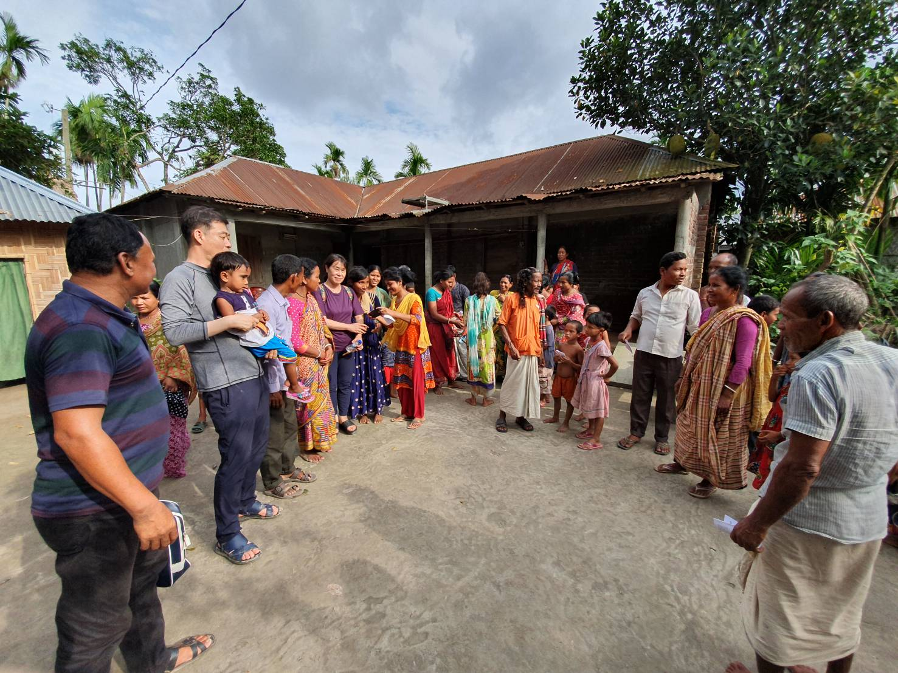
Village Gospel 乡村福音

Slide 7
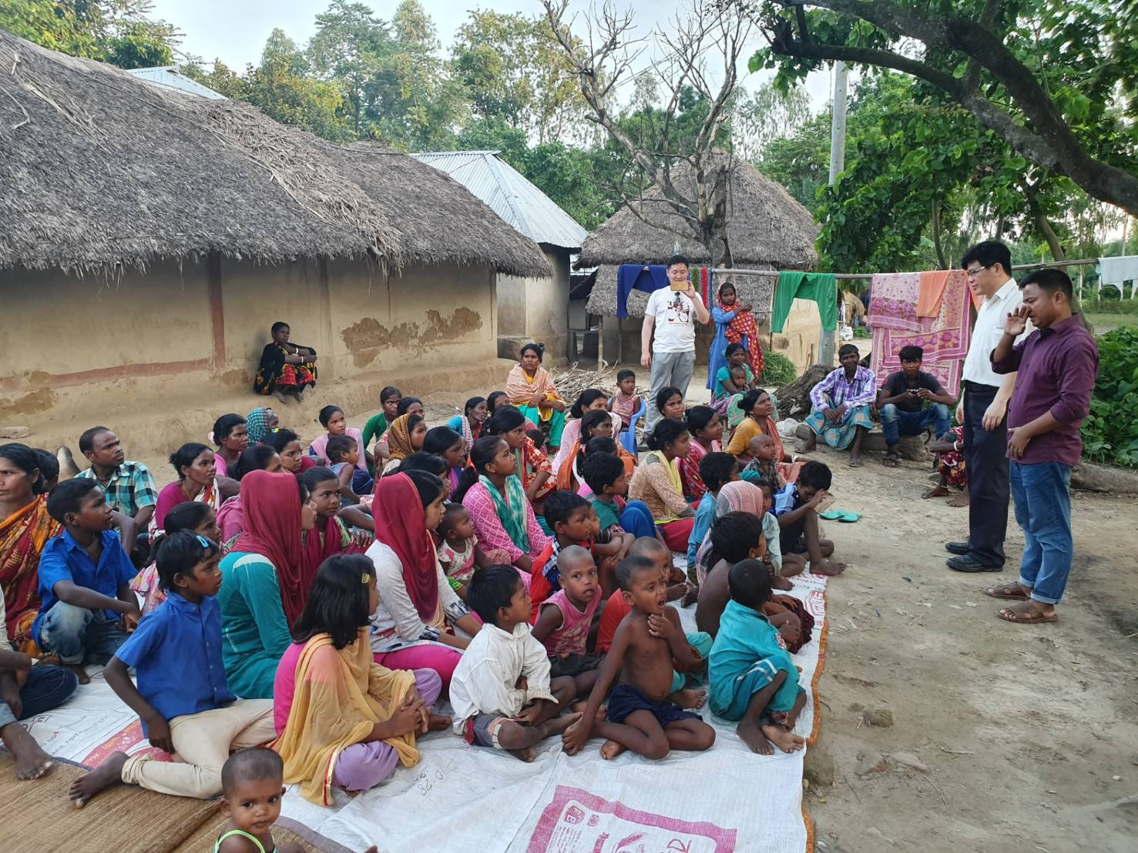
Village Gospel 乡村福音

Slide 8
Baptize 受浸

Slide 9
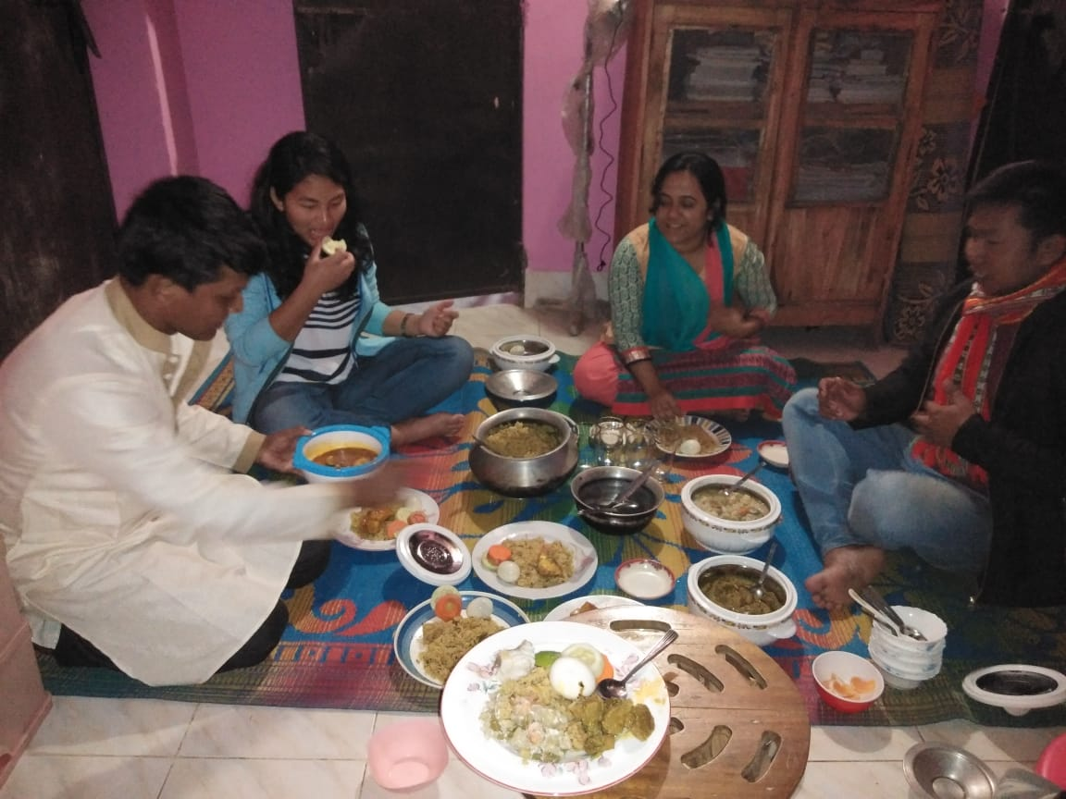
Home loving feast 家爱宴

Slide 10
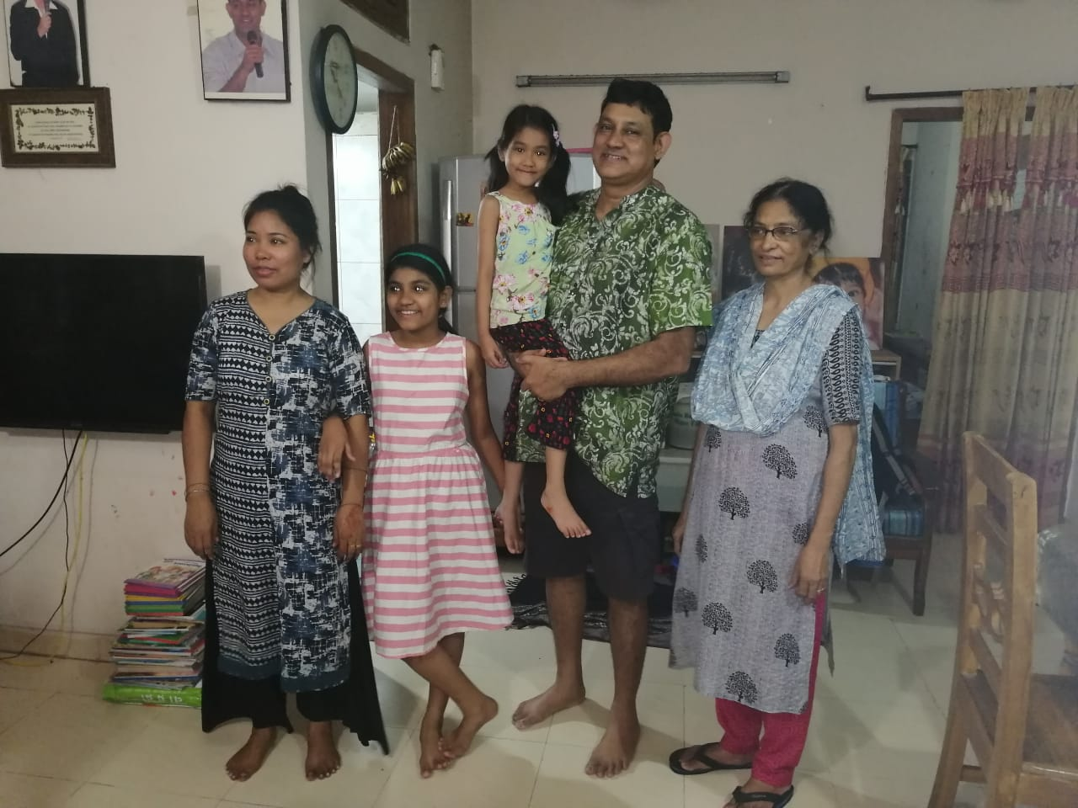
Home Shephreding家牧养

Slide 11
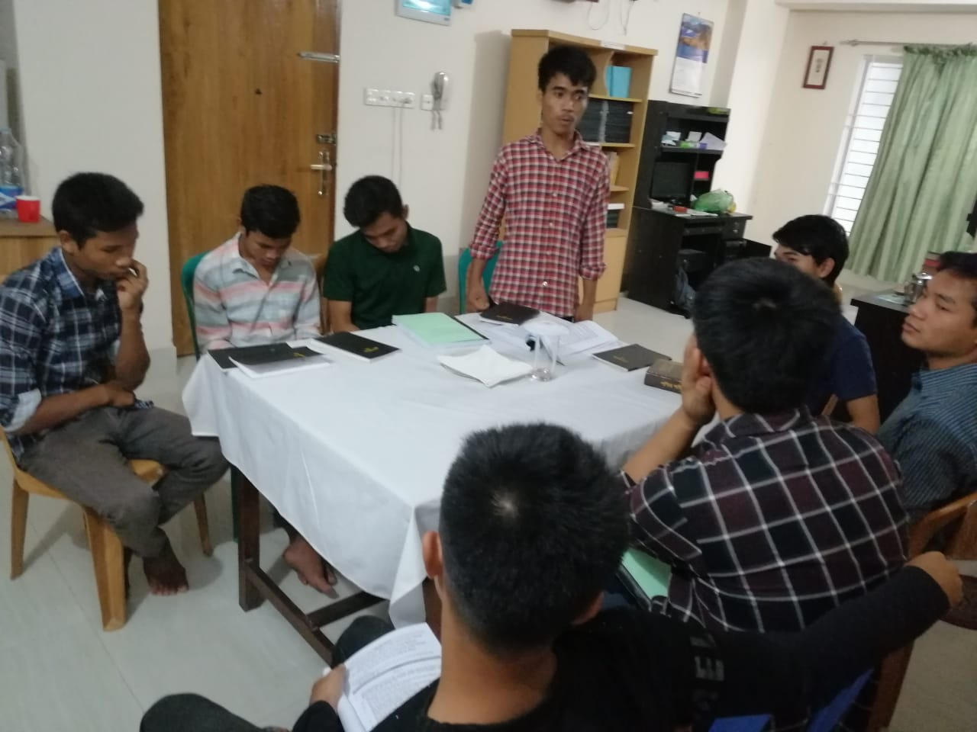
Group Meeting 排聚集

Slide 12
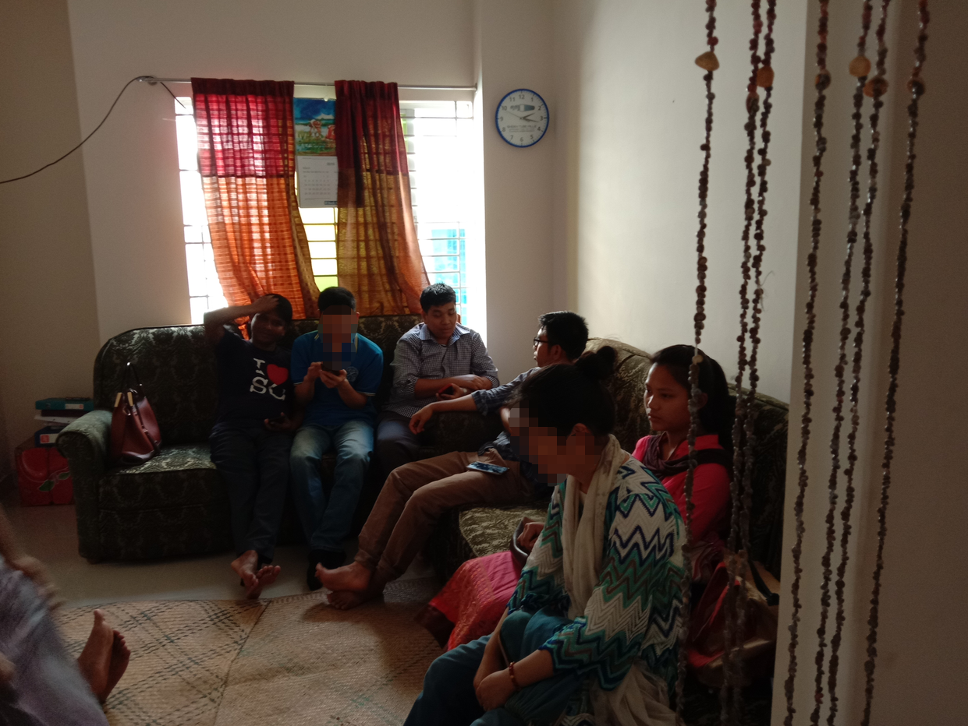
Group Meeting 排聚集

Slide 13
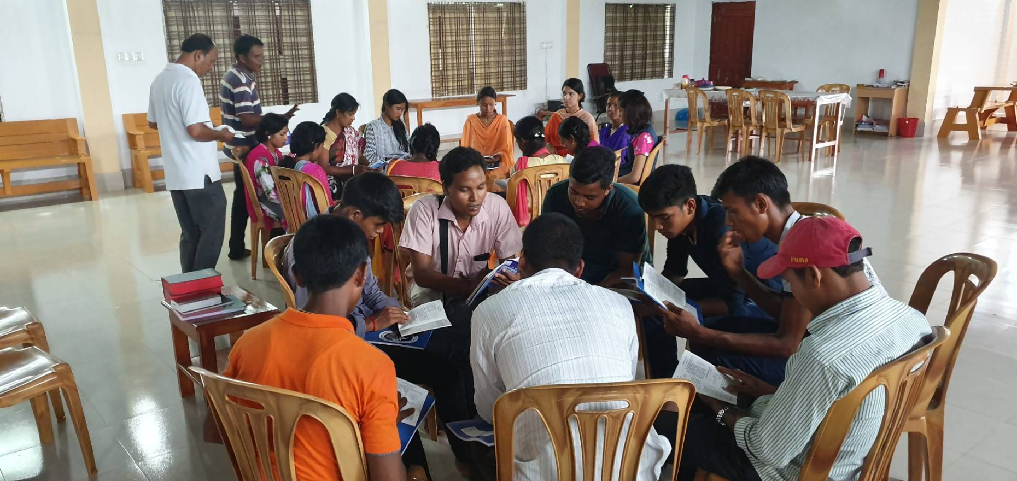
Training 训练

Slide 14
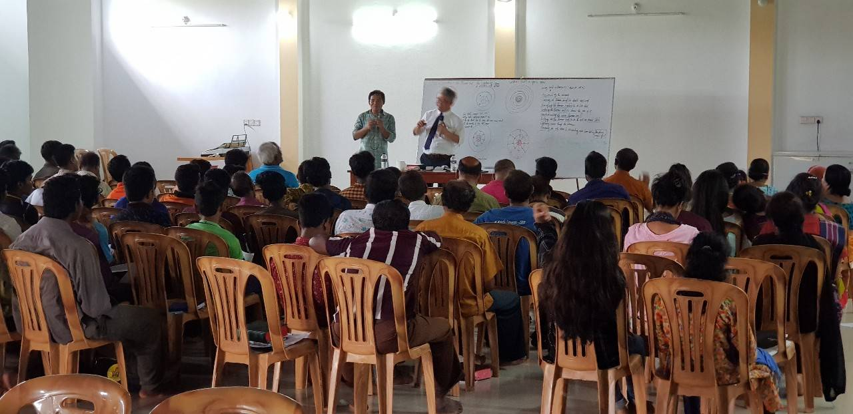
Training 训练

Slide 15
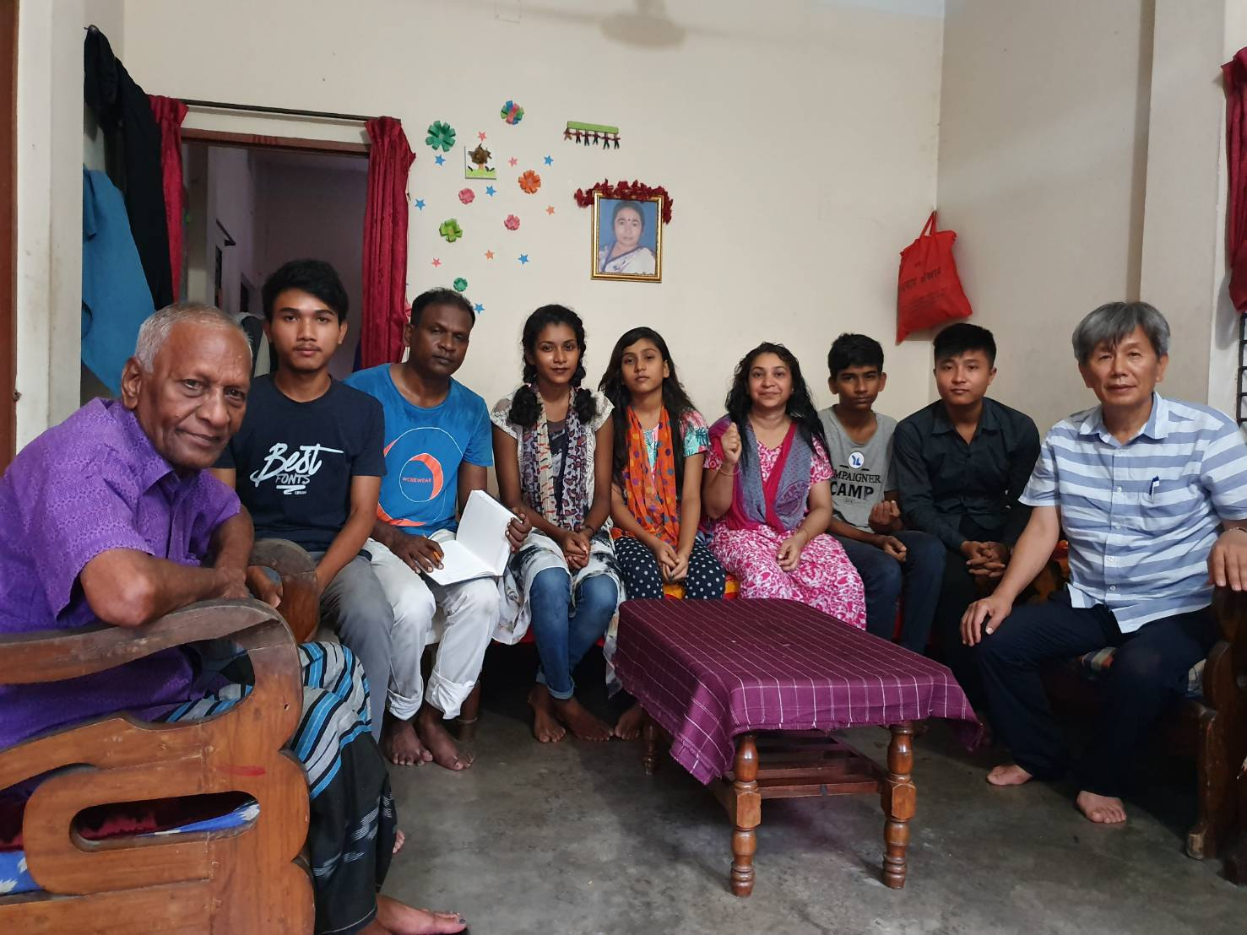
Blending 相调

Slide 16
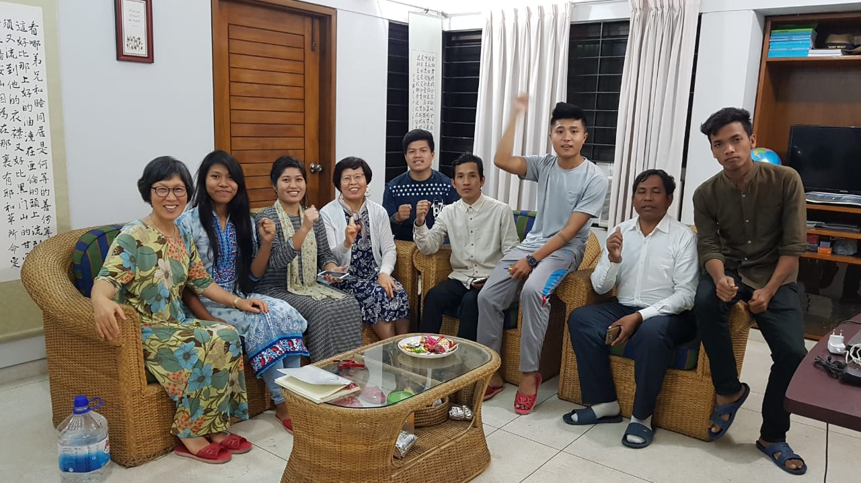
Blending 相调

Slide 17
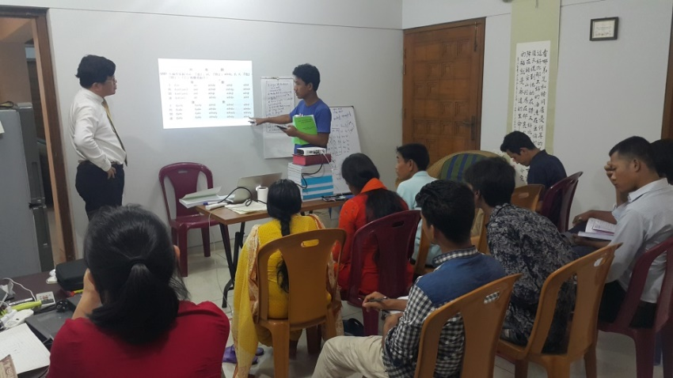
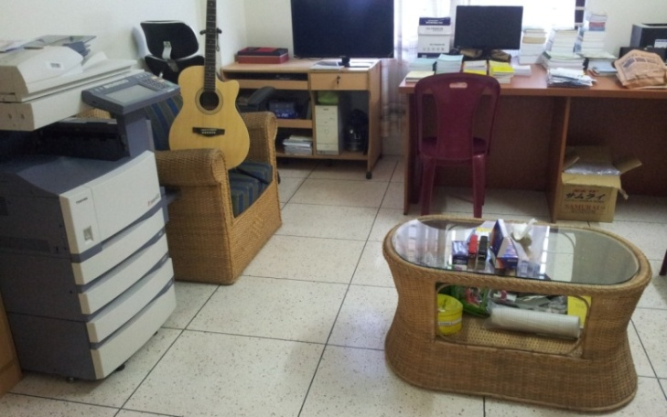
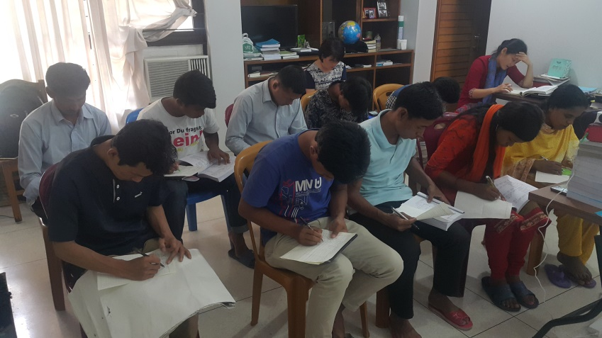
Literature 文字

Slide 18
Statistics
Country 国家 | BD
Current no. of Churches 现有召会数 | 138
Current no. of Saints 现有圣徒人数 | 12000
Calendar of Events November 2019- October 2020
Goals for 2020 目标
Target no of churches 目标召会数 | 158
Target no of saints 目标圣徒人数 | 13000

Slide 19
2020 Calendar of events in Bangladesh 2020年孟加拉国行事历
 | Date | Location | Gospel/Training/Conference/Blending/ Setting up Testimony
 | March 26-27 | Dhaka | Serving one’s blending 服事者相调 Young people meeting 青年训练
 | June 2-7 | Dhaka-Chittagong | Gospel- Intensified Propagation 加强福音行动
 | August 10-16 | Dhaka-Chittagong | Gospel- Intensified Propagation 加强福音行动
 | September 10-11 | Chittagong | Young people’s training 青年人成全
 | October 8-9 | Dhaka | Young people’s training 青年人成全 Serving ones training 本地服事者训练

Slide 20
Prayer request 代祷请求
1，Literature - May the Lord rise up more translators, so that the truth and hymn of the Lord’s recovery can be more translated into Bengali.
2, Gospel –May the Lord gain more young families, and open their house to become a solid testimony here.
3, Perfecting- May the Lord gained more young people be perfected by the truth, seeing the vision, and practice God’s ordained way.
4. Training- Raise up the short term training
5. Training center constraction work- we have already one meeting hall for 400 saints get together; one brother dormitory for 80 brothers to stay and one office. Now we are under the constraction work of 2 floors of the sister dormitory, dining hall and kichen (1st floor is dining hall and teacher’s room and kichen, 2nd floor for teacher’s room.)
1，文字- 求主兴起翻译的人才，使主恢复的真理和诗歌能够更多的被翻译为孟加拉语。
2，福音 - 得着更多年轻的家，能够打开家成为祂在这里扎实的见证。
3，成全 - 得着青年人被真理成全，看见异像实行神命定之路。

