Slide 1
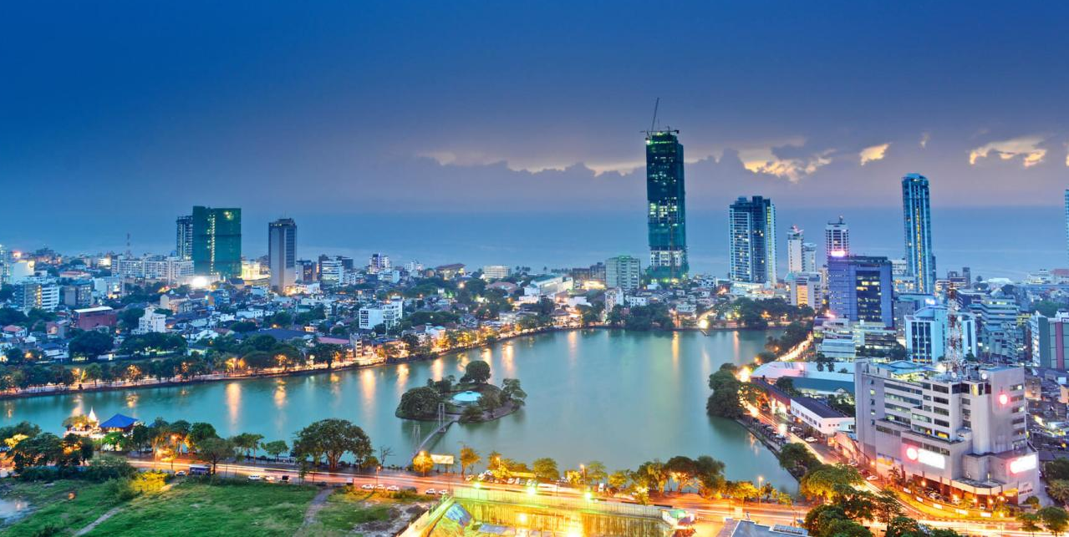
Lord’s Move in Sri Lanka
主在斯里蘭卡的行動
Oct. 2017 – Sep. 2018

Slide 2
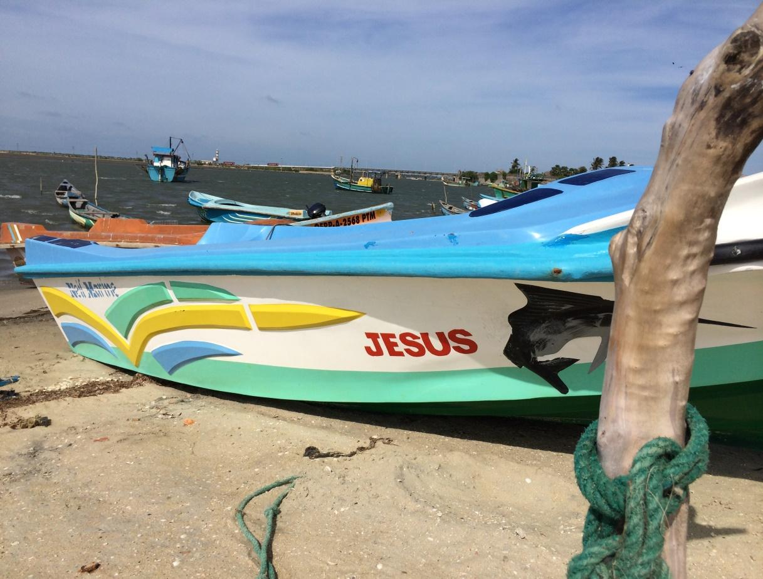
Present Situation - Goal
現況 -目標

Slide 3
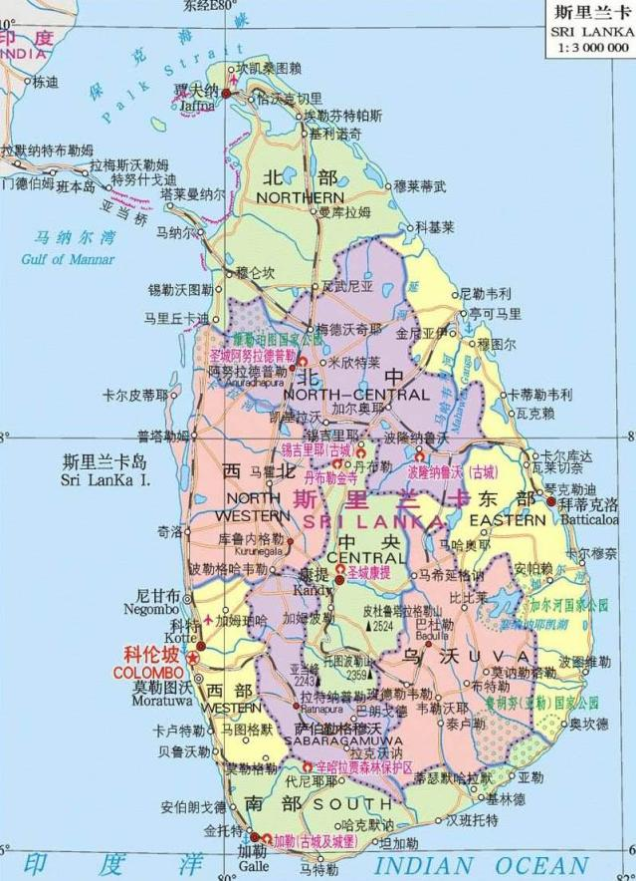
Establishment & Propagation of Churches (召會成立與開展)
No | Year of Est. | Locality | 2018 LTM Aver. (Aug-Sep)
1 | 2004 | Colombo | 48
2 | 2006 | Kandy | 20
3 | 2006 | Polonnaruwa | 8
4 | 2011 | Batticaloa | 12
5 | 2012 | Jaffna | 17
6 | 2012 | NuwaraEliya | 10
7 | 2012 | Kurunegala | 41
8 | 2014 | Wattala | 7
9 | 2015 | Mannar | 22
10 | 2015 | Kekirawa | 10
11 | 2015 | Panadura | 9
12 | 2016 | Trincomalee | 4
13 | 2017 | Vavuniya | 10
14 | 2017 | Moratuwa | 10
15 | 2018 | Gampaha | 22
16 | 2018 | Kilinochchi | 18
Sum (合計) | 267

Slide 4
Statistics/Goal 現況統計與目標
 | Lord Day aver. (Aug-Sep) |  | Churches No | Church Life
 | No | Increase
2014 | 105 | 0 | 8
2015 | 157 | +52 | 11 | 313
2016 | 185 | +28 | 12 | 383
2017 | 239 | +54 | 14 | 494
2018 | 267 | +28 | 16 | 528

Slide 5
Statistics of God-ordained Way
Church Lord’s Table | Colombo (48) |  | Kurunegala (41) |  | Jaffna (17) |  | Killinochch (18)
Gospel | 14 | 29% | 8 | 20% | 15 | 88% | 9 | 50%
Home Meeting | 25 | 52% | 12 | 29% | 15 | 88% | 7 | 39%
Small Group | 55 | 114% | 42 | 102% | 24 | 141% | 20 | 111%
Prophesy% | 40 | 83% | 35 | 85% | 15 | 88% | 12 | 67%

Slide 6
Colombo City / Colombo Region
Year (年) | Colombo City LD Ave. Aug-Sep (主日平均8-9月) | Colombo Region
 |  | LD Ave. Aug-Sep (主日平均8-9月) | Churches (召會數)
2015 | 29 | 43 | Colombo Wattala (2)
2016 | 26 | 46 | Colombo Wattala Panadura (3)
2017 | 37 | 84 | Colombo Wattala Panadura (3)
2018 | 48 | 97 | Colombo Wattala Panadura Moratuwa Gampaha (5)

Slide 7
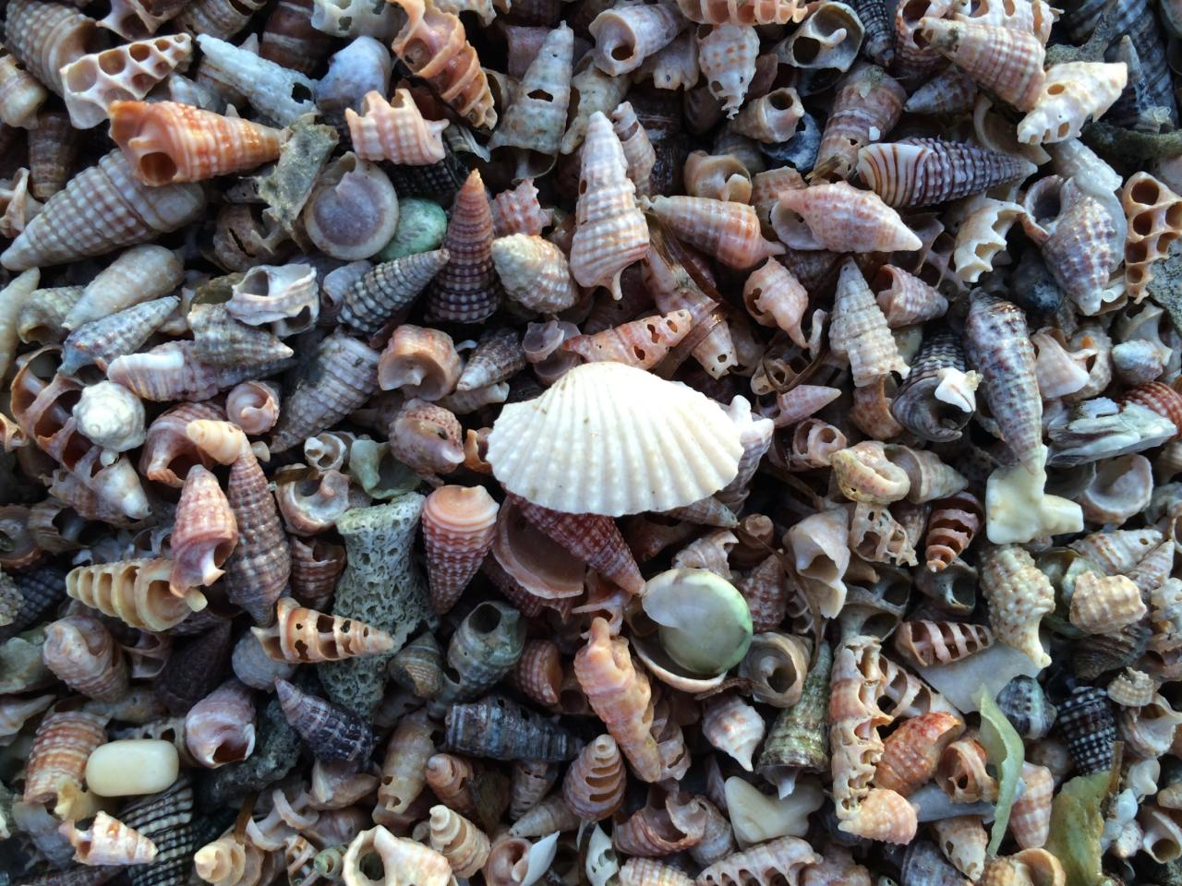
Gospel Propagation-
Establishing Churches
福音開展-成立召會

Slide 8
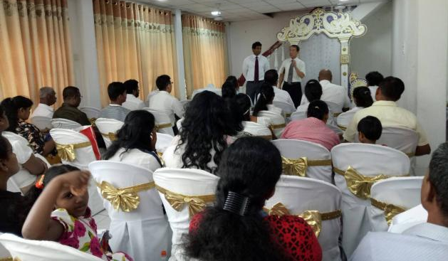
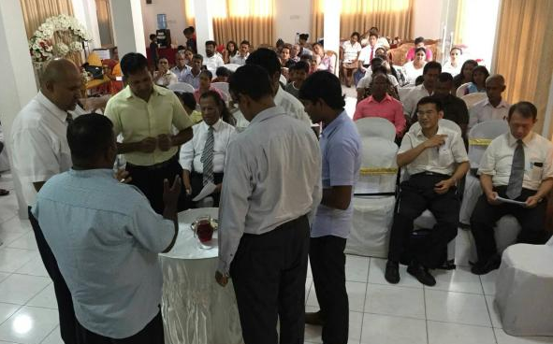
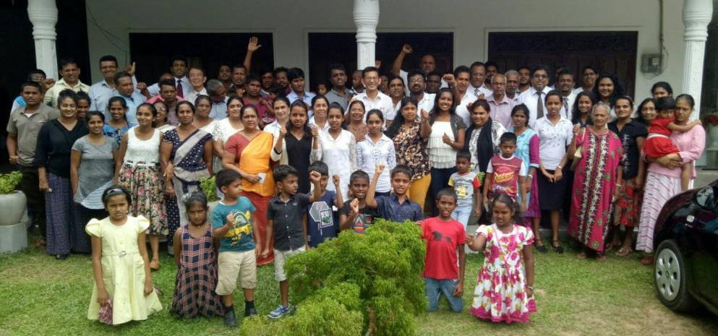
First Lord’s Table Meeting in gampaha
Gampaha第一次主日聚會 March 25, 2018

Slide 9
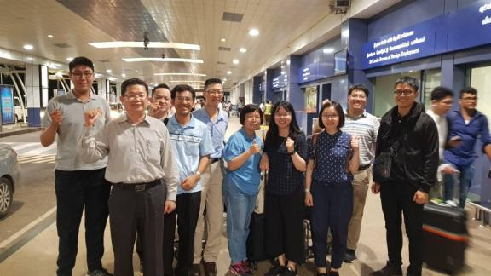
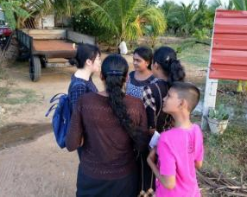
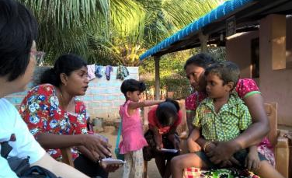
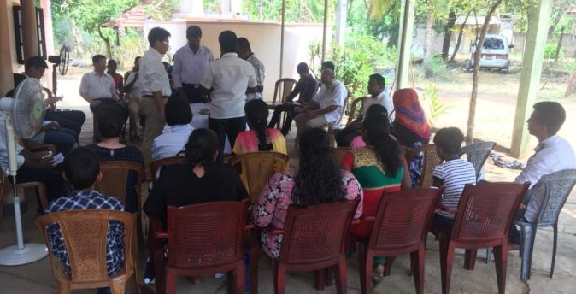
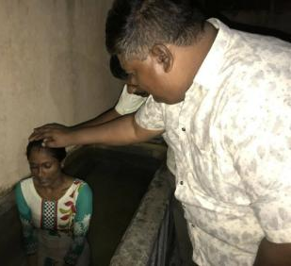
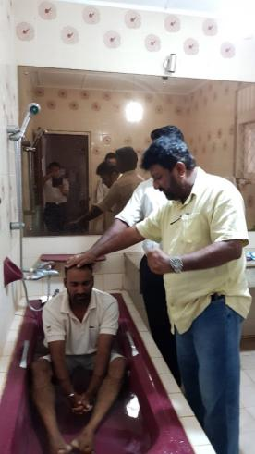
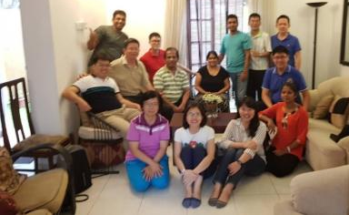
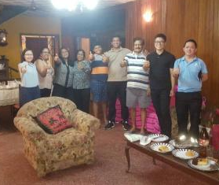
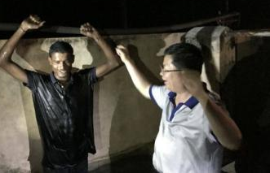
Propagation by Full-timers from Kaohsiung
高雄全時間者開展April 11 - June 11, 2018

Slide 10
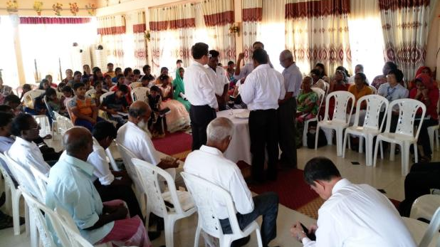
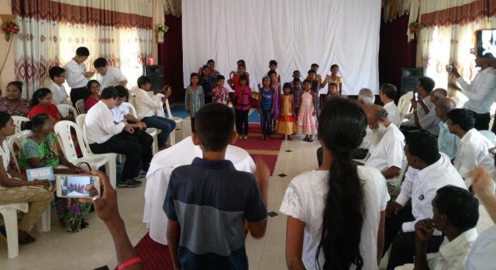
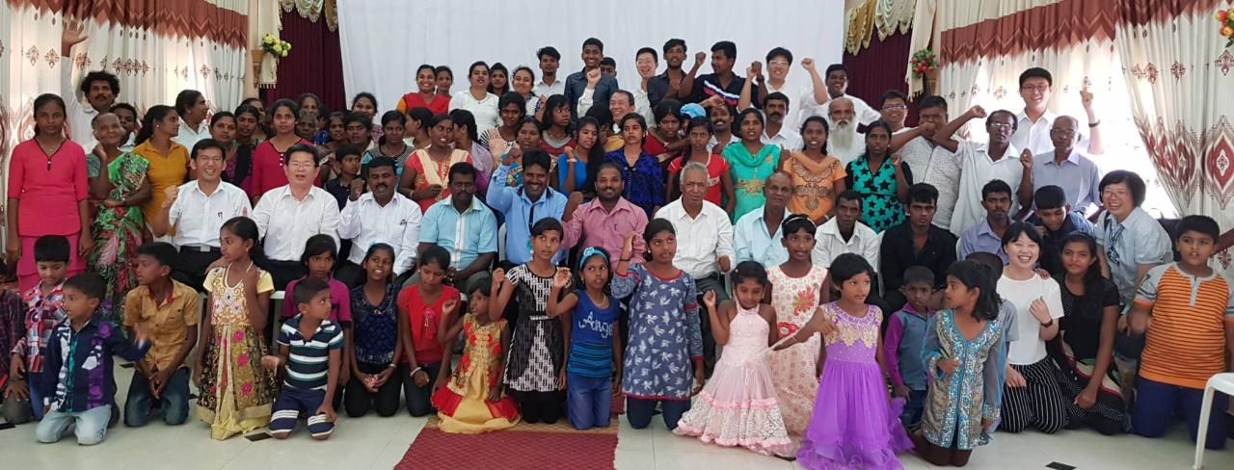
First Lord’s Table Meeting in Kilinochchi
Kilinochchi 第一次主日聚會 April 29, 2018

Slide 11
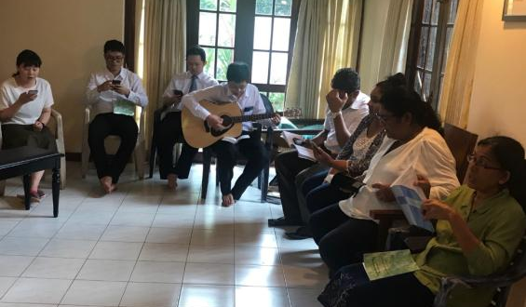
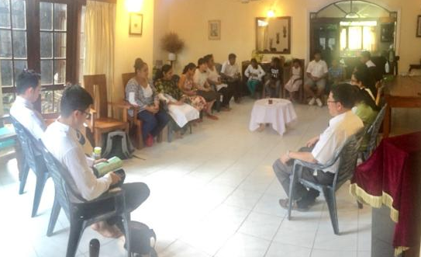
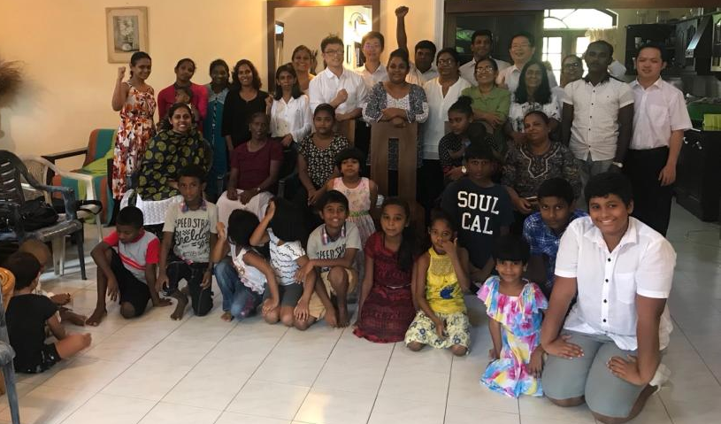
First Lord’s Table Meeting in Colomb-3
可倫坡第三區 主日聚會 May 20, 2018

Slide 12
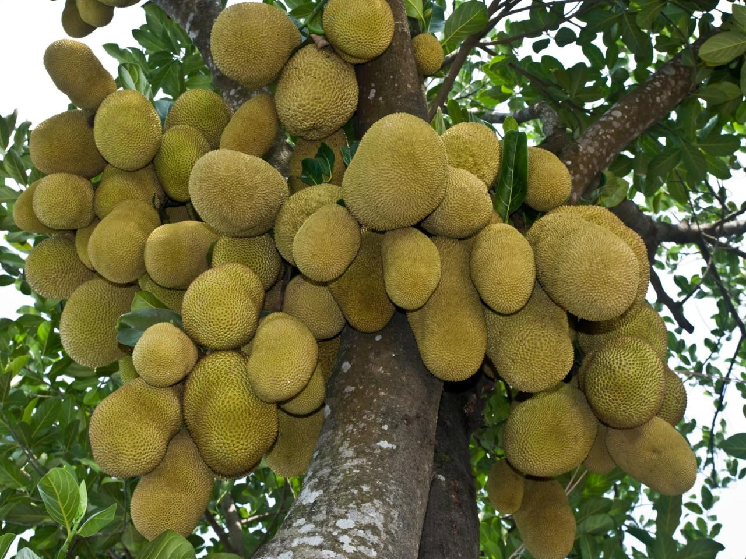
Establishing Home Meetings-
Bearing Remaining Fruit
設立家聚會-結長存果子

Slide 13

Material for Home Meetings
家
聚
會
材
料

Slide 14
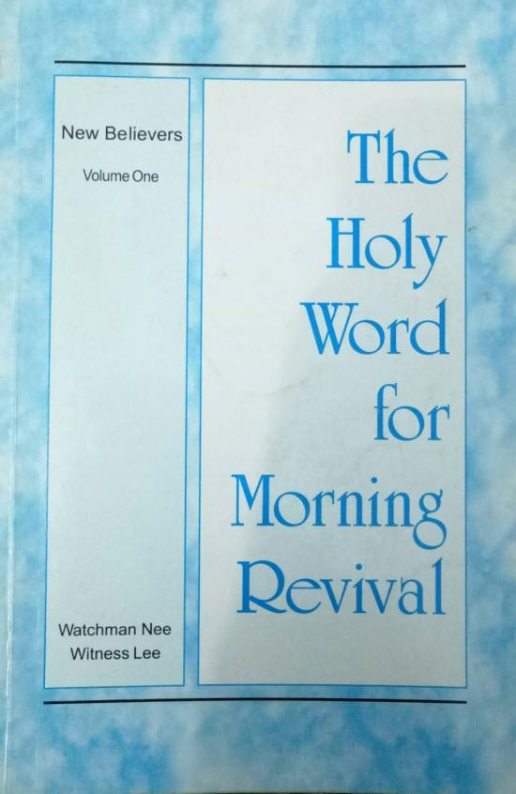
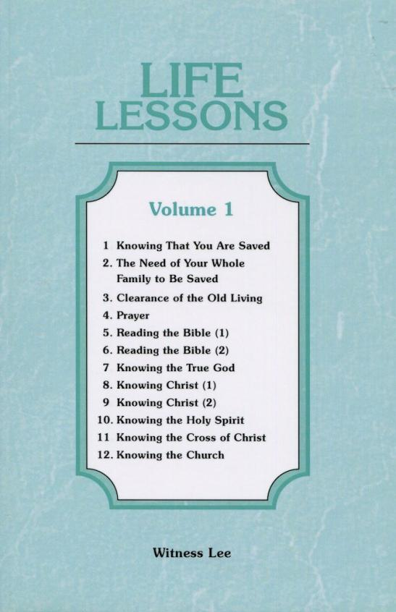
Material for Home Meetings
家
聚
會
材
料

Slide 15
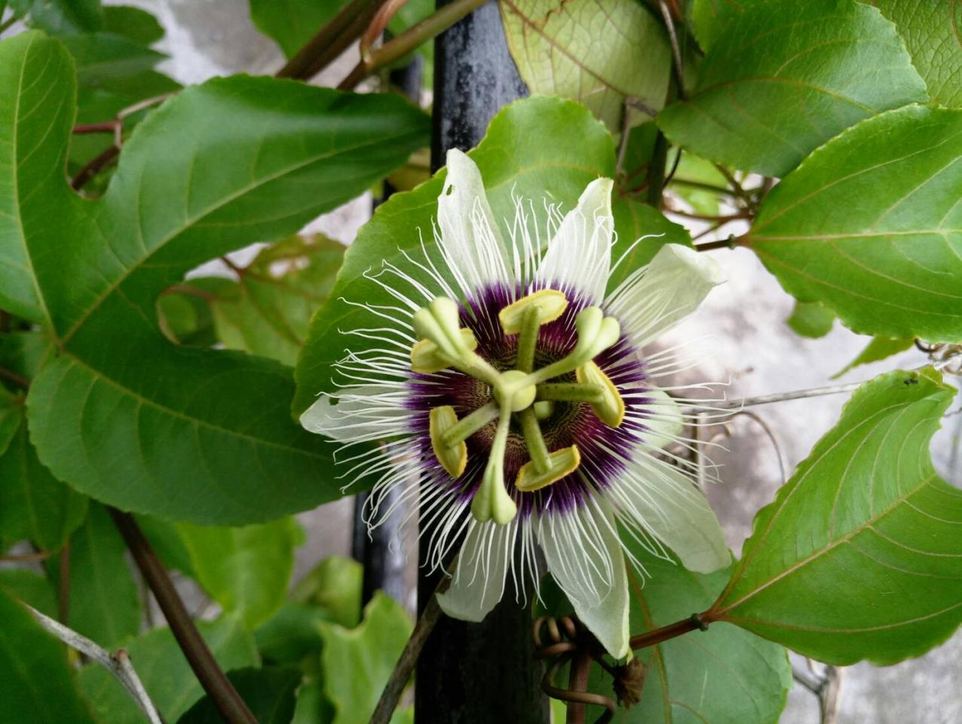
Literature Translation-Publication
文字翻譯-出版

Slide 16
Spiritual Books
New Believers Morning Revival Vol. 1,2
Life Lessons Vol. 1,2,3
Milk of the Word for New Believers Vol.1
Shepherding Material Vol. 1 & 2
Holy Word for Morning Revival (7 Feasts)
Genuine Church Life
Recovery of the Church
Goal of the Lord’s Recovery
Leviticus vol. 1,2
Material Offerings for the Lord’s Move
Taking Christ as Our Person

Slide 17

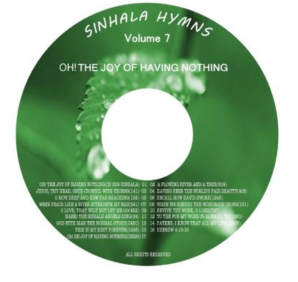
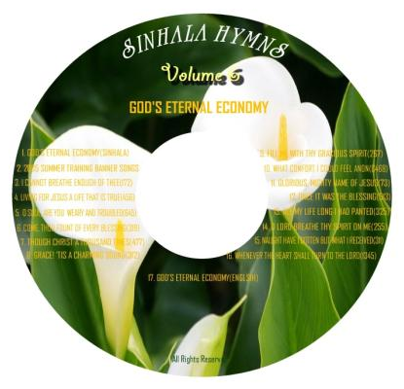

Hymns in Sinhala 僧伽羅語詩歌
Volume 6
Volume 7

Slide 18
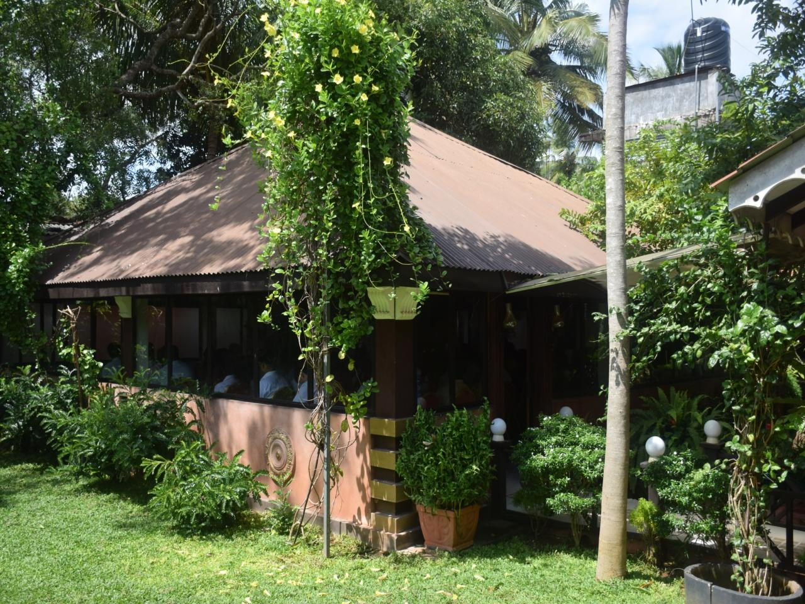
Training
訓練

Slide 19
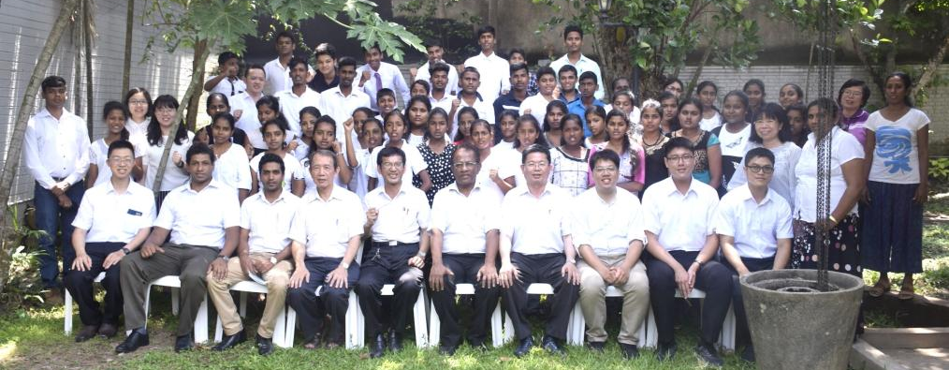
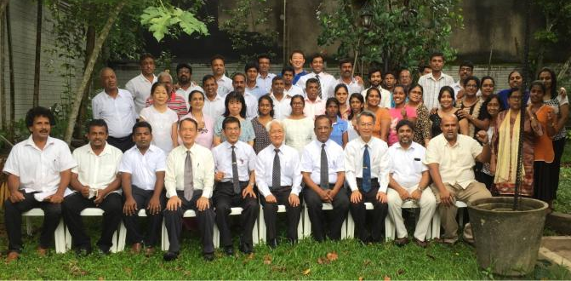
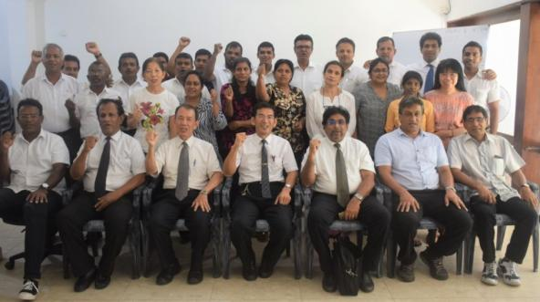
Training 訓練
Training for Young People
Training for Serving Ones
Training for Full-timers

Slide 20
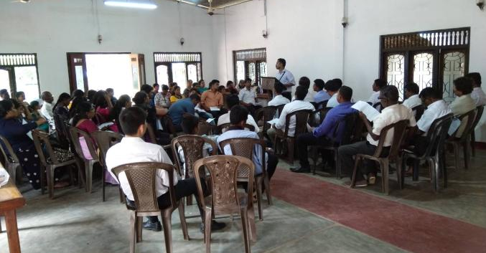
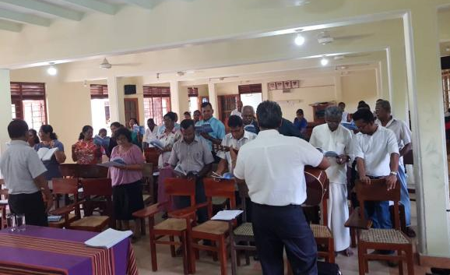
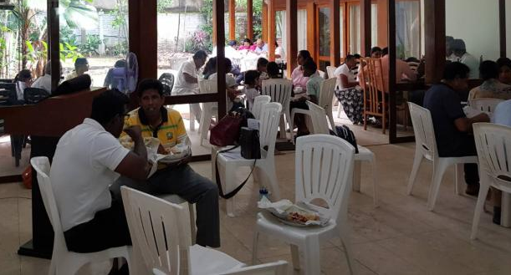
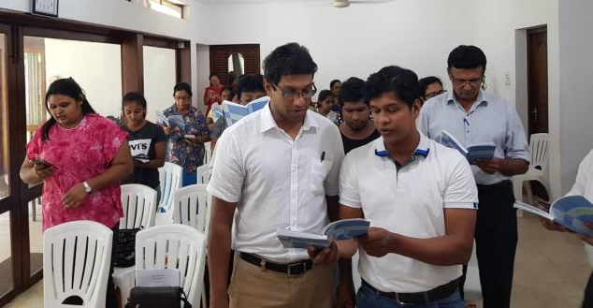
Training on Poya Day 訓練
Vavuniya (Jaffna Region)
Kurunegala (Kandy Region)
Colombo (Colombo Region)

Slide 21
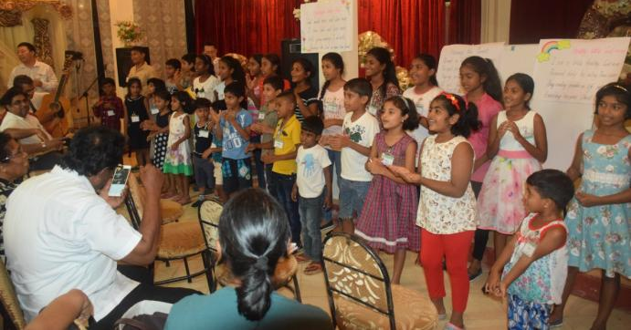
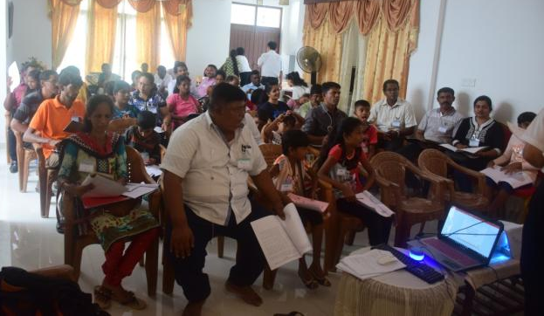
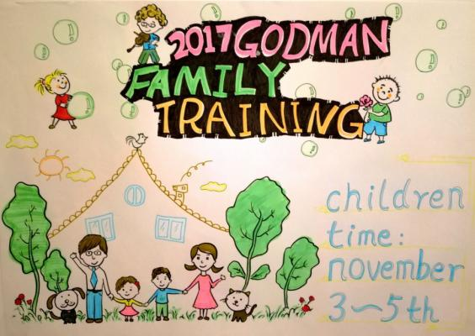
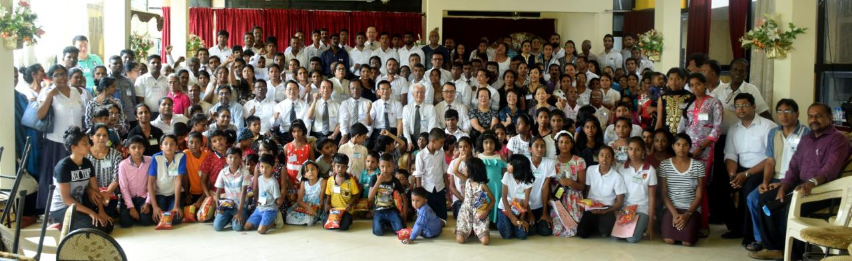
God-man Family Training (60) 神人家庭訓練 Kurunegala Nov. 03-05, 2017

Slide 22
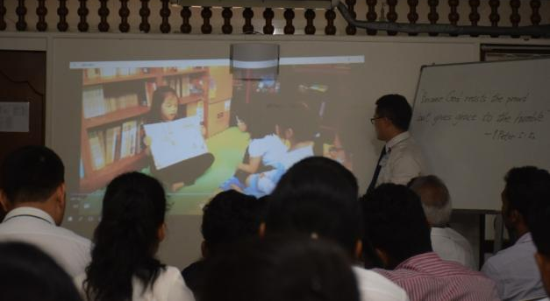
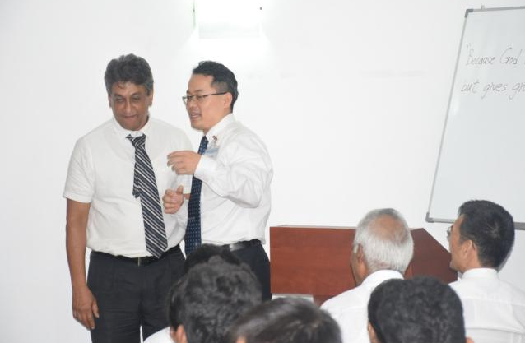
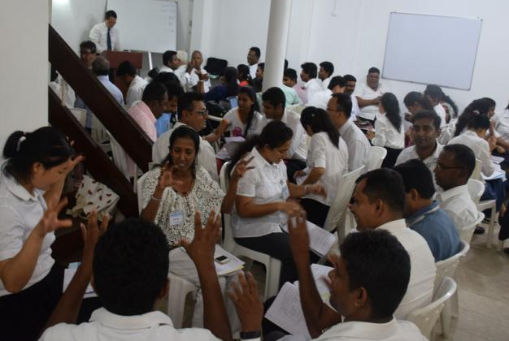
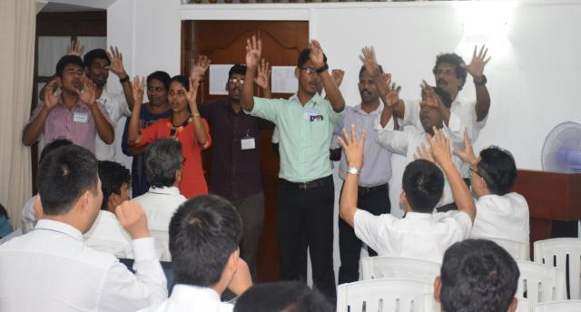
Training for Children’s Vital Group
兒童活力排訓練 Colombo Jan. 29-31, 2018

Slide 23
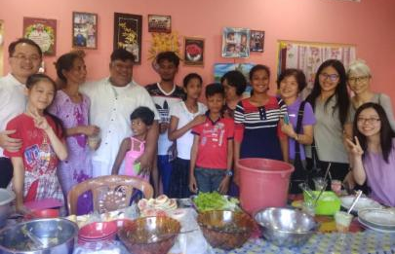
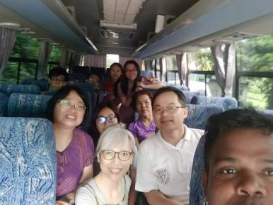
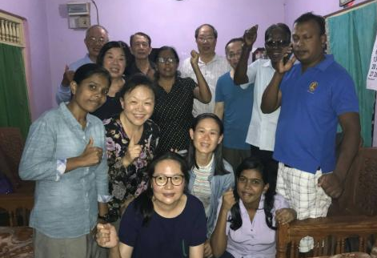
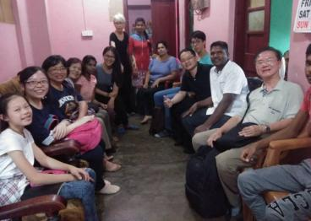
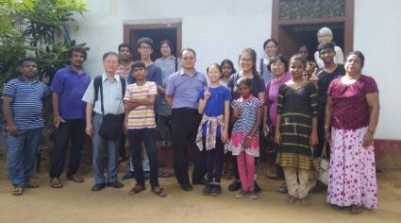
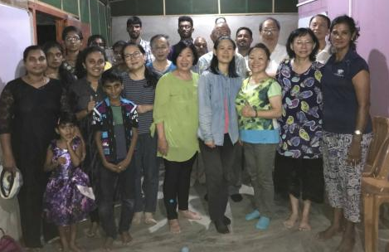



Visiting and Blending of Taiwan Luke and Children Group Aug. 20-27 2018
Mannar
Trincomalee
Jaffna
Vavuniya
Batticaloa
Polonnaruwa
Kilinochchi

Slide 24








Visiting and Blending of Taiwan Luke and Children Group Aug. 20-27
Kurunegala
Kandy
Kekirawa
Nuwara Eliya
Colombo
Panadura
Gampaha&Wattala

Slide 25




台灣路加與兒童團訪問相調
Visiting and Blending of Taiwan Luke and Children Group Aug. 20-27

Slide 26



2018 National Blending Conference
2018年8月全國特會
Total No. 403
Adult:326
Children: 77

Slide 27

Young People’s Work-Full-timers
青年工作-全時間者

Slide 28







Two Weeks Propagation by College Saints from Kaohsiung
高雄大專兩週開展June 30 –July 12, 2018
Colombo
Gampaha
Kurunegala
Jaffna
Kandy

Slide 29



1 sister has finished two-year’s training in Batam.
1 sister is undergoing training in FTTND.
6 young ones will go for training in 2019.

Slide 30
Goal-Prayer
目標-代禱

Slide 31
By End of 2020-Goal
1 | Colombo:100 saints joining the LTM.
2 | 100 Parents-Children Vital Groups.
3 | 100 Campus Students joining the LTM.
4 | 25 Local Churches.
5 | New Testament Recovery Version in Sinhala.
6 | Purchasing Land and Building the Training Center.

Slide 32
Prayer
NO | Item
1 | Releasing Sons of Peace/Families of the Seekers.
2 | Shepherding New Ones using Shepherding Materials.
3 | Propagating Colombo.
4 | Gaining parents by Children Vital Groups.
5 | Attending the full-time training in Batam of Six Young people in 2019.
6 | Translating NT Recovery Version in Sinhala.
7 | Purchasing Land and Building the Training Center.

