Slide 1
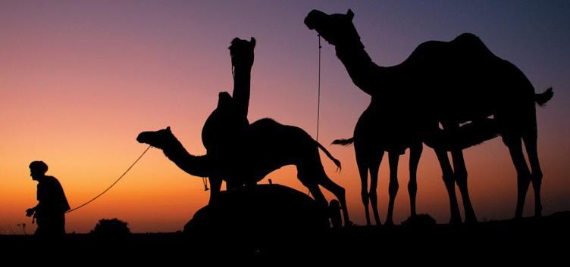
The Lord‘s Move in India
主在印度行动简报
October, 2018

Slide 2
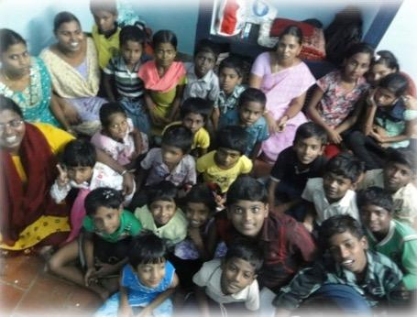
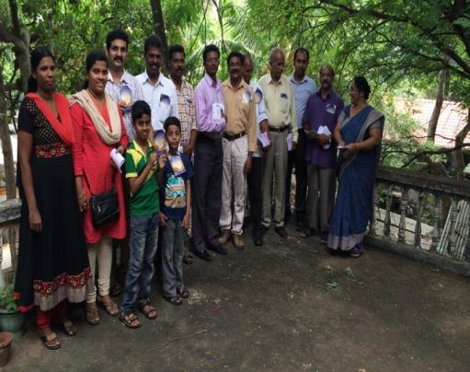
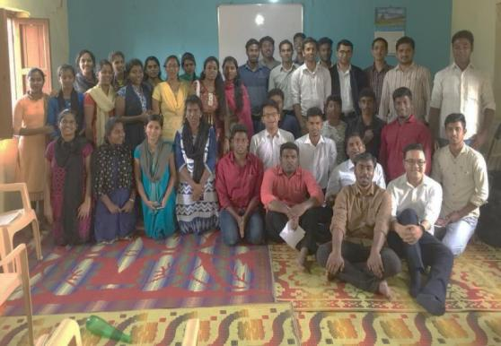
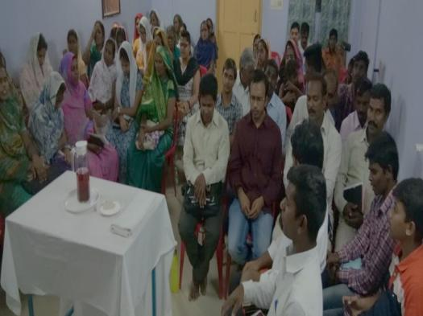
The Churches in India
印度众召会概况

Slide 3
181
4359
6548
8
Churches
Saints Partaking
the Lord’s Table
Saints in the Church life
and Under Shepherding
Churches Established

Slide 4
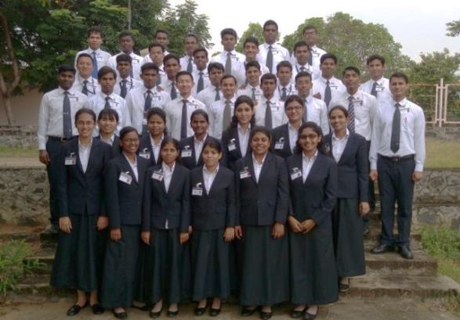
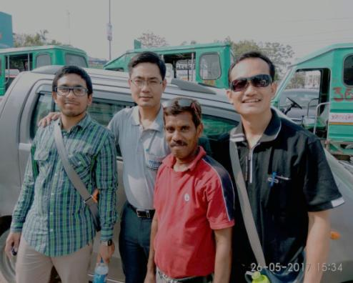
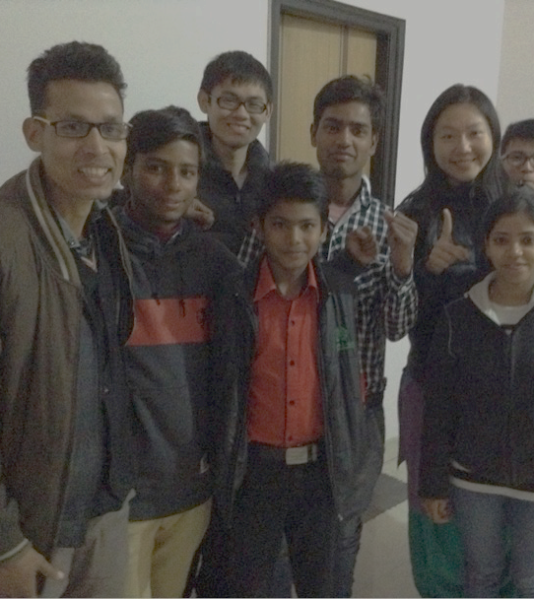
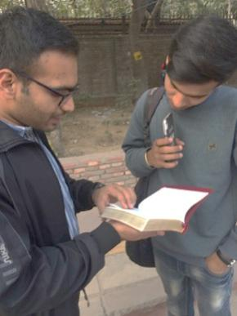
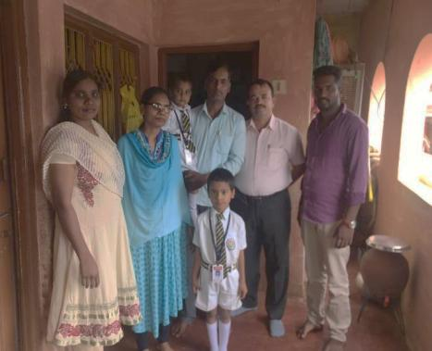
The Burden of the Work in India
印度工作负担

Slide 5
1.
Being Constituted with the Truth
2.
Building up Local Churches—Increasing
被真理构成
建造众地方召会
－繁殖
3.
Propagation New Churches—Spreading
4.
Producing Manpower —Next Generation
开展新召会－扩增
产生人力－兴起下一代

Slide 6
Being Constituted with the Truth
被真理构成

Slide 7
Two Aspects of Pursuing
两方面的追求
Truth Education
真理教育
7 Feasts
一年七次特会

Slide 8
7 Feasts
一年七次特会
Video Training
录像训练
100
Church Registration
Translation
Into 9 Languages
7
Feasts
Serving Ones Training
事奉者训练
翻译为九种语言
350→500
Saints Participation
Holy Word for
Morning Revival 晨兴圣言
Regional Conference
区域特会
6 Areas

Slide 9
Truth Education
真理教育
Though
God-ordained Way
Everyone Enters
Everyone Speaks
Translation
Into 5 Languages
人人进入
人人讲说
借着神命定之路
Shepherding
Materials
牧养材料
翻译为五种语言
Translation
Into 5 Languages
Released
Book by Book
Churches Long Term
Pursuing
召会按进度
长期进入
Life-Study
Reading Plan
生命读经
阅读计划
逐卷出版
翻译为五种语言

Slide 10
Recovery Version Bible
Translation Project
恢复本圣经翻译计划
புதிய ஏற்பாடு Tamil (泰米尔语)
പുതിയ നിയമം Malayalam (马拉雅拉姆语)
కొత్త నిబంధన
Telugu (泰卢固语)
Current Progression:
Book of Romans
नए नियम Hindi (印地语)
(Start from 2018)
नवीन करार Marathi (马拉提语)
ಹೊಸ ಒಡಂಬಡಿಕೆ Kannada(康纳达语)
PATHIAN LEHKHABU THIANGHLIM Mizo (米佐语)

Slide 11
Building Up Local Churches—Increasing
建造众地方召会－繁殖

Slide 12
2016-2020 —5 Years Plan 5年计划
50
Major Cities
with Strong Testimony
主要城市有强的见证

Slide 13
2 Major Burdens 二个主要负担
Perfecting Serving Ones
产生事奉者
Establishing the Model of God Ordained Way
建立神命定之路的模型
Responsible brothers being built up together. 负责弟兄被建造在一起
Producing young serving ones 产生年轻事奉者
Gospel Living 福音生活
Shepherding 牧养
Small group 小排
Statistics 统计

Slide 14
Practical Steps 具體步驟
Coworkers Entering into the Burden
同工训练进入负担
Coworkers &
Responsible Brothers
Major Cities Building up the Models
大城市作出模型
Major Cities
Extending to Different States
延伸至各州
States
Perfecting Young Serving Ones
产生年轻事奉者

Slide 15
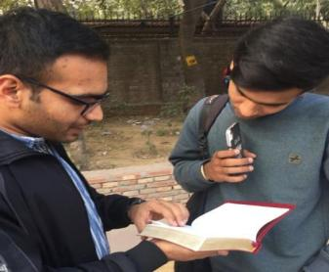
Coworkers Entering into the Burden
同工训练进入负担
1. Paying attention on statistics and review weekly
注重统计，并且周周检核
2. Taking the lead to practice God ordained way (Campus team goal: 10 times going out per week)
带头操练神命定之路（校园开展队目标：每周外出开展10时段）
3. Perfect the saints to practice God ordained way and share the burden with the churches
成全圣徒操练神命并且向众召会传输负担

Slide 16
Major Cities Building up the Models
大城市作出模型
1. Senior coworkers visited major cities to perfect the leading brothers and serving ones 年长同工访问主要城市成全负责弟兄及事奉者
237*
Delhi
91*
2. Strengthening the priesthood and practicing the Increasing of groups and districts
加强事奉体系，实施增排增区
Hyderabad
308*
Chennai
3. Practicing gospel preaching and shepherding, paying attention on statistics
实行福音与牧养，注重统计
124*
Trivandrum
* Figure shown is the no. of the saints in the Lord’s Table

Slide 17
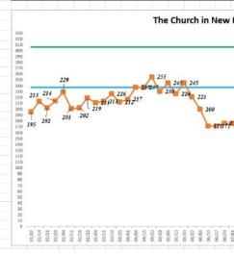
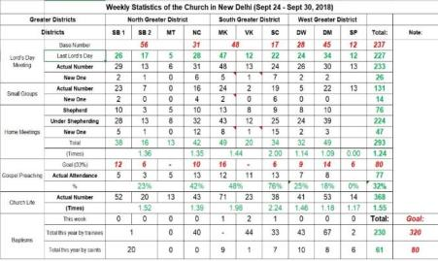
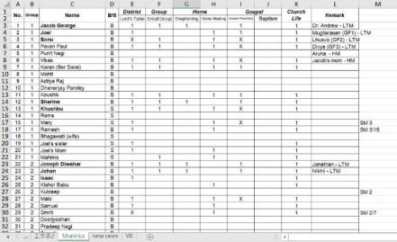
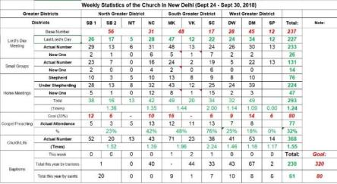
Major Cities Building up the Models—Statistics 大城市作出模型—统计
Base Number
Shepherding
Name List
Lord’s Table
Gospel Preaching
Small Group
Life Study Pursuing
Home Meeting

Slide 18
Major Cities Building up the Models
大城市作出模型
5. Major cities taking care the propagation and perfecting of nearby cities 主要城市开始顾到周边城市的开展与成全
Delhi
Gurugram
Miraj
6. Inviting other bigger churches to be blended bringing into the same flow.
邀请同区其他大城市相调进入相同水流
Guntur
Hyderabad
Nellore
Chennai
Pondicherry
Bangalore
Tuticorin
Tirunelveli
Trivandrum

Slide 19
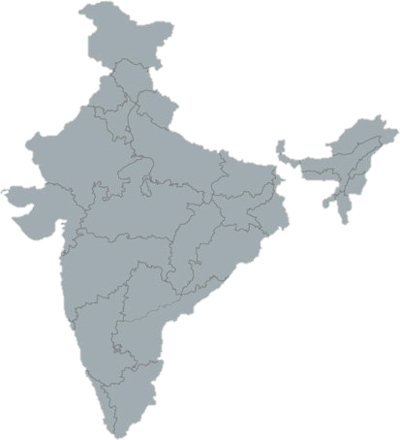
Extending to Different States—Home Meeting
延伸至各州—家聚会
Percentage of Saints Going out for Home Meeting
各州聖徒出访家聚会比例
North 31%
North East /%
Maharashtra 17%
Karnataka 19%
Andhra Pradesh /%
Kerala /%
Tamil Nadu 36%

Slide 20
Propagation of New Churches—Spreading 开展新召会－扩增

Slide 21
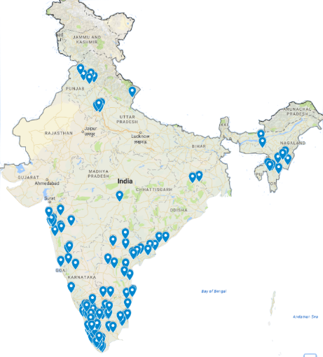
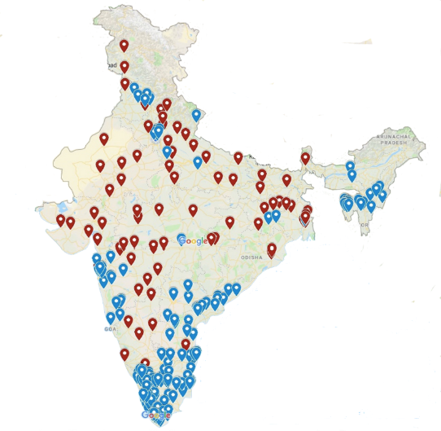
Burden 负担
Gaining All the Major Cities (14/29 states no church)
得着所有主要城市（目前仍有14州（共29）没有召会）
Whole Body Propagating India
全身体一同开展印度

Slide 22
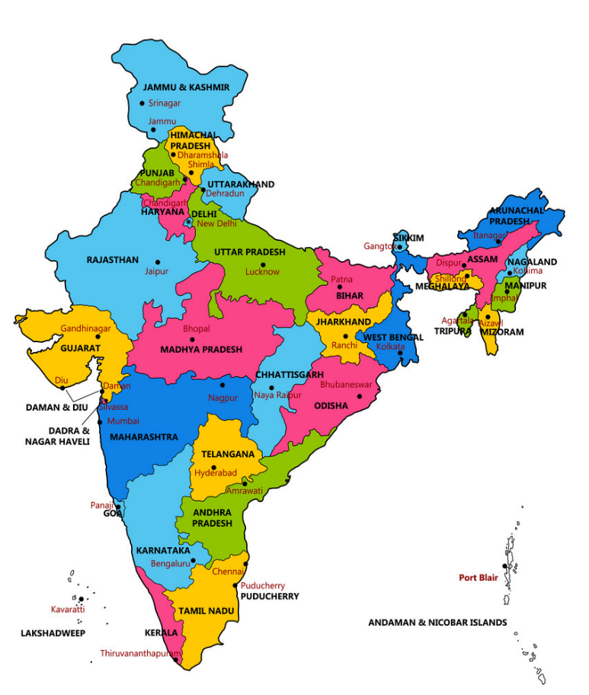
Gospel Move in India (8/1-21) 印度福音行动
Kolhapur
Major City in Maharashtra
0.54 Million
Itanagar
Capital City of Arunachal Pradesh
Thirupathi*
Major City in
Andhra Pradesh
0.3 Million
Hubli
Major City in Karnataka
0.94 Million
Nandyal
Major City in
Andhra Pradesh
0.3 Million
Mysuru
Major City in Karnataka
0.92 Million
Madurai
Major City in
Tamil Nadu
1.56 Million

Slide 23
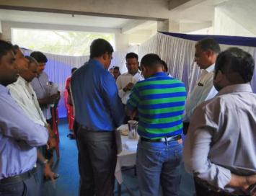
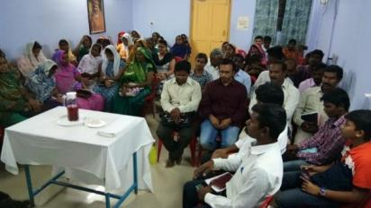
Gospel Move in India (8/1-21) 印度福音行动
Testimony 见证
Hubli
Thirupathi

Slide 24
North India 5 Years Plan
New Delhi & NCR >> 1000 Saints
Chandigarh & Ludhiana >> 100 Each
Strengthen the Existing Major Cities
加强主要城市
Establishing the Model 建立模型
Producing the Man Power 产生人力
Establish the Churches in Major Cities of North India 在北印度主要城市建立召会
2016-18
2018-19
2019-20
Spreading of the Ministry
推广职事书报
Sowing the Seed 洒种
Supplying the Seeking Ones 供应寻求者

Slide 25
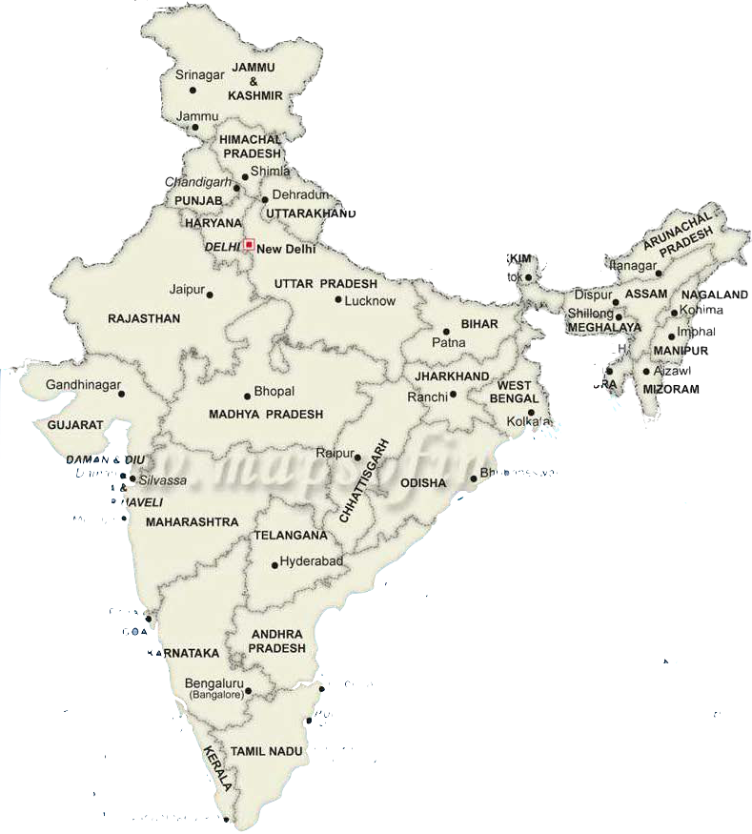
North India Literature Distribution Trip 北印度书报推广
Jammu & Kashmir
Dhanoo, Udhampur
Jammu, Reasi, Katra
Himachal Pradesh
Solan, Shimla, Manali,
Kullu, Mandi, Gaggal,
Kangra, Naddi, Dharamsala,
Jharkhand
Ranchi,
Jamshedpur,
Chaibasa,
Simdega,
Gumla, Khunti,
Hazaribagh
Chhattisgarh
Raipur,
Mahasamud,
Bagbahar
West Bengal
Kolkata, Barasat,
Basirhat,
Delhi
Uttar Pradesh
Raebaleri, Amethi,
Faizabad, Ayodhya,
Bihar
Patna
Sikkim
Gangtok, Majitar,
Namchi,
Tripura
Agartala

Slide 26
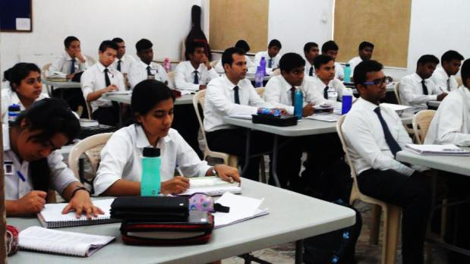
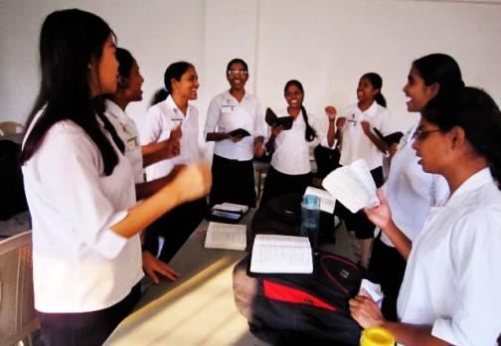
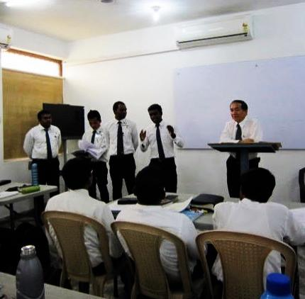
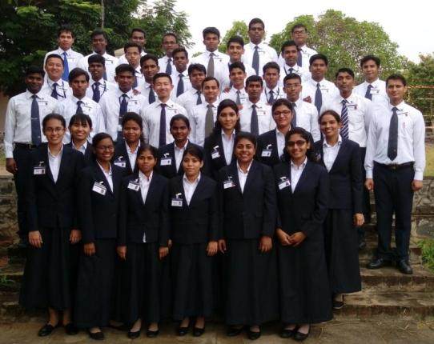
Raising Up the Next Generation
兴起下一代

Slide 27
Burdens—A Year of Changing Concepts负担—改观念
Establishing the Service Teams
产生事奉体系
Knowing the Situation by Statistics
藉统计了解现况
Focusing on God-ordained Way
注重神命定之路
Everyone Functioning
(Student Work Done by Students)
人人尽功用
(学生工作学生作)

Slide 28
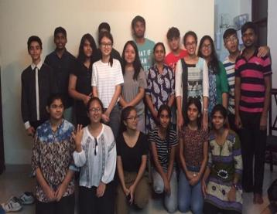
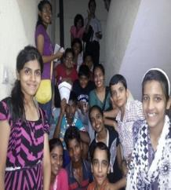
Campus Work
校园工作
1. Establishing Gospel Living—Gospel
建立福音生活—福
2. Pursuing the Truth
—Recovery Version Study Group
— Home and Small Group.
追求真理－恢复本圣经读经小组
—家与排
3. Short-term Full-time Training
短期全时间训练

Slide 29
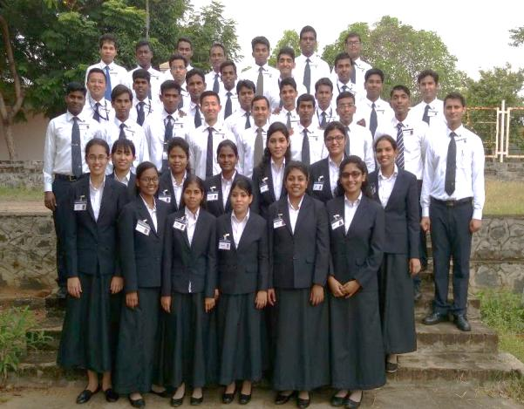
Full-time Training in New Delhi全时间训练中心
43
Trainees
40
Full-time
3
Short-term

Slide 30
Land Purchasing Project in Chennai
印度清奈购地计划

Slide 31
Burden －the Important Step of the Lord’s Move in India 负担 －带进主在印度行动重要突破
Breakthrough in material offering 财务奉献的突破
Breakthrough in experiencing the Body of Christ 对基督身体经历上的突破
Breakthrough in the blending among the churches 在众召会相调事上的突破
The need of perfecting the saints to change the system for practicing God-ordained way 对神命定之路改制上成全的需要

Slide 32
Update of Offering from India (In Rupees) 印度部分奉献概况 (卢比)
Description | City Name | Goal Amount | Present Amount | %
Place of Buying | Chennai | 30,000,000 | 16,683,653 | 55.61
Major Cities | New Delhi | 6,250,000 | 4,408,965 | 70.54
 | Trivandrum | 2,075,000 | 2,593,300 | 124.98
 | Mumbai | 3,250,000 | 1,854,500 | 57.06
 | Hyderabad | 2,075,000 | 1,149,730 | 55.41
 | Bangalore | 1,125,000 | 1,482,365 | 131.77
Other area | Maharashtra | 6,074,750 | 3,884,278 | 63.94
 | Tamil Nadu | 18,776,500 | 6,000,760 | 31.96
 | Kerala | 8,836,000 | 2,136,700 | 24.18
 | Karnataka | 2,209,000 | 2,271,150 | 102.81
 | AP & T | 8,283,750 | 3,386,650 | 40.88
 | North India | 5,522,500 | 435,000 | 7.87
 | North East | 5,522,500 | 1,534,560 | 27.79
 | Other | - | 167,000 | -
Total |  | ₹ 100,000,000 | ₹ 51,732,853 | 51.59%
 |  | US$1,492,537 | US$751,544

Slide 33
Prayers
代祷事项

Slide 34
Being constituted with the truth:
(1) The saints’ being constituted with the truth by using “Shepherding Material”
(2) Recovery Version Translation Project
(3) The participation of video training
Building up the local churches:
(1) Churches establish the structure of gospel & home meetings
(2) Raising up 500 pillars
Raising up the new churches and shepherding of the new churches
Gaining young generation from the campuses in major cities
被真理构成:
藉使用牧养材料使圣徒被真理构成
恢复本圣经翻译计划
众召会圣徒能参与录像训练
建造地方召会
(1) 众召会建立福与家的架构
(2) 兴起 500 位柱子
兴起新召会及其后续牧养
主要城市的校园开展

