Slide 1

The Lord's Move to Cambodia
主在柬埔寨的行動

Slide 2
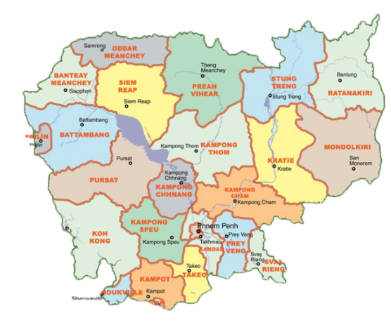
Introduction to Cambodia 柬埔寨簡介
25 Provinces and One Capital City
二十五個省及一個首都
There are 17 churches in Cambodia
柬埔寨共有17处召会

Slide 3
Direction
行動方向
1
Gospel 福音
2
Home Visitation 家聚會
3
Small Group 小排聚會
4
District Meeting 區聚會
5
Literature 文字工作
6
Conference &Training 特會和訓練

Slide 4
1
Gospel 福音
Gospel
Gospel
Gospel
01
02
03
Campus Gospel
校園福音
Gospel Move
福音行動
Community Gospel
社區福音

Slide 5
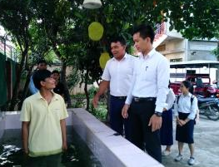
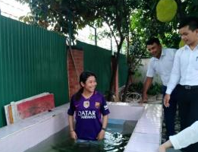
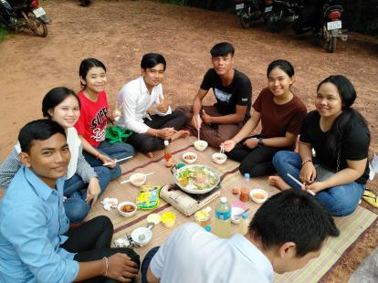
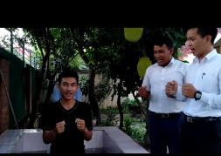
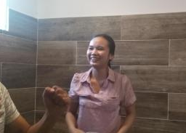
Campus Gospel 校园福音

Slide 6
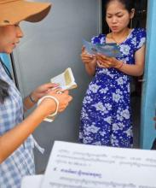
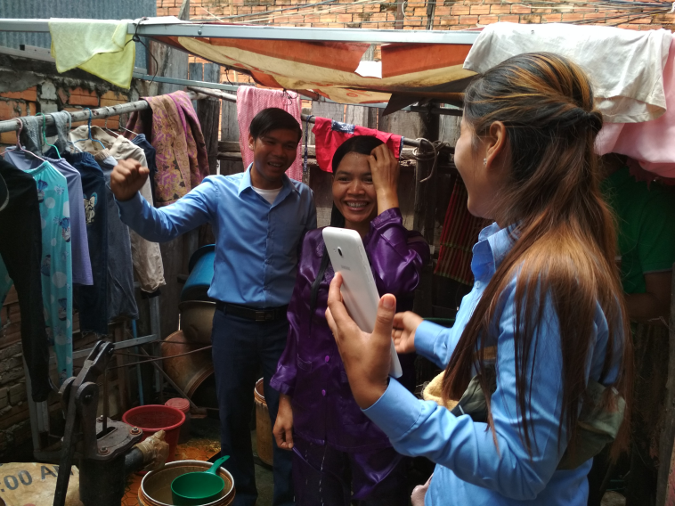
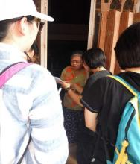
Gospel Move 福音行動
Through saints' laboring and coordination , we got some fruits.
借着圣徒的劳苦和配搭，我们得着了一些果子。

Slide 7
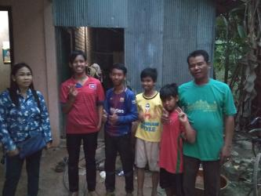
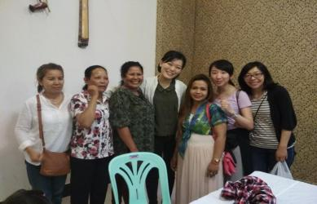
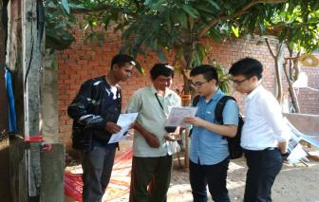
Community Gospel 社區福音
Brothers and Sisters Laboring in Gospel
許多弟兄姊妹在福音上勞苦

Slide 8
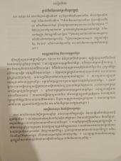
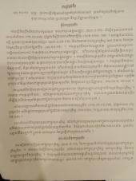
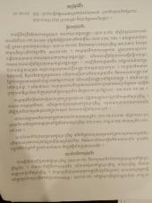
Home Visitation 家聚會
2
Through the laboring of saints in the translation on Nourishing Materials , of which three former series have been accomplished by now. Besides, we try to put it into use in the way of home visitation.
借著聖徒在翻譯上的勞苦，牧養材料的前三個系列已經翻譯完成。並且我們已在家餵養中投入使用。
The Excerpts from Nourishing Materials
牧養材料職事信息

Slide 9

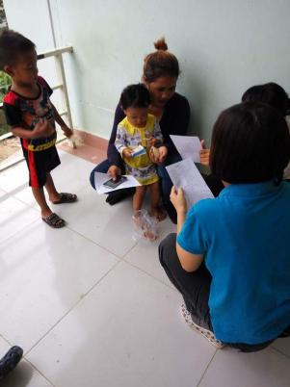
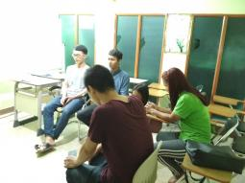
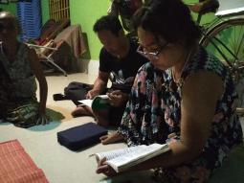
We lead and help the local saints to get into the enjoyment of the Nourishing Materials in their house, which issues in the growth of divine life.
我們帶領並幫助聖徒們在家中進入享受牧養材料，使他們在神聖生命上有長大。

Slide 10
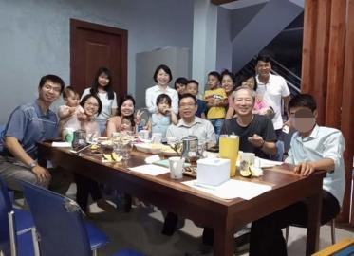
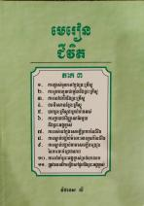
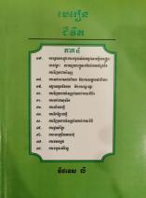
3
Small Group Meeting 小排聚会
Loving Feast 小排愛宴
Life lessons
生命課程系列

Slide 11

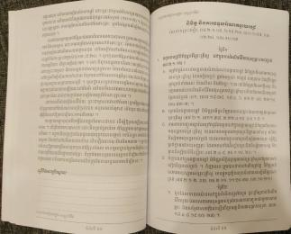
4
District Meeting 区聚会
We the churches in Cambodia closely follow the leading of the ministry, especially the seven feasts, which is the living ,timely and up-to-date words of God to us.
柬埔寨的众召会仅仅跟随职事的带领，特别是一年七次特会，特会的说话乃是神对我们活的、及时的、并够上时代的说话。

Slide 12
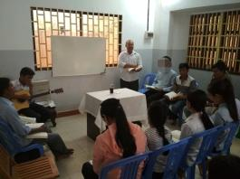
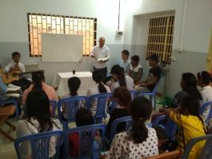
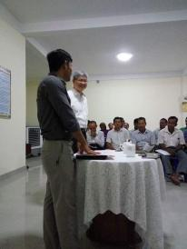
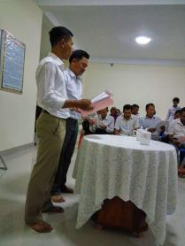
本地聖徒各個操練他們的靈在主日申言，為主說話，並說出主來。
Local saints one by one exercise their spirits to prophesy on the Lord's Day, to speak for the Lord and speak forth the Lord.

Slide 13
5
Literature 文字工作
Literature
Literature
Literature
Literature
01
02
03
04
HWMR
晨興聖言
Hymns
詩歌
Outlines for Training
訓練綱要
Khmer Bible of Recovery Version & Other spiritual books
柬文恢复版圣经和其他属灵书报

Slide 14
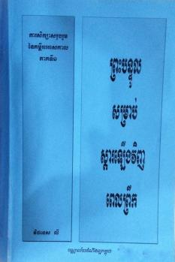
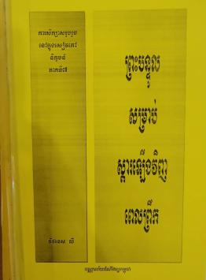
HWMR 晨興聖言

Slide 15

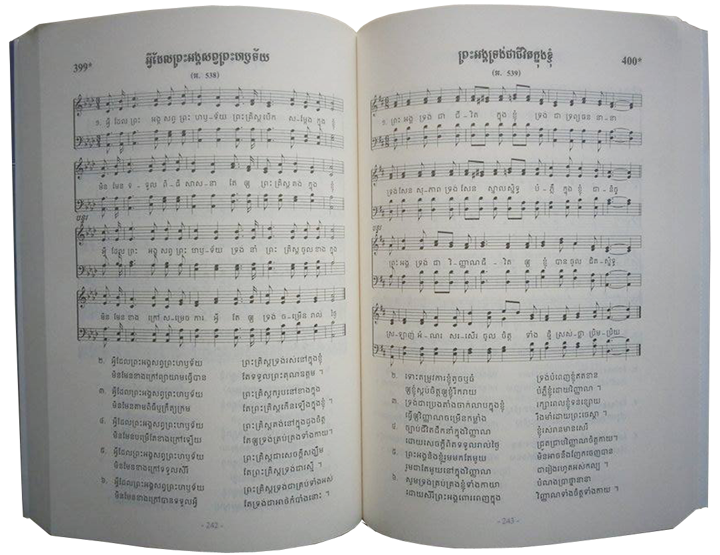
Hymns 詩歌
Translating and editing 500 Hymns
翻譯並編輯500首詩歌

Slide 16
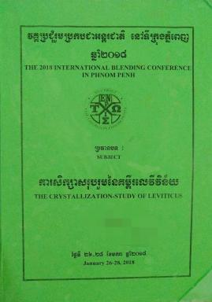

Outlines for Training
訓練綱要
Outlines for various
kinds of trainings
各種訓練綱要

Slide 17
1. Concerning the Khmer Bible of Recovery Version.
关于柬文恢复版圣经
Now we have translated the verses of Matthew, Mark, Luke, John, Acts, Romans, 1 Thessalonians, 2 Thessalonians, 1 Timothy, 2 Timothy, Titus, Philemon, Hebrews, James, 1Peter, 2Peter, 1 John, 2 John, 3 John, Jude, the first seven chapters of 1 Corinthians and the first five chapters of Revelation and the first draft of the foot notes of Mark, Luke, John, Acts, 1 Timothy.
我们已经翻译了马太福音、马可福音、路加福音、约翰福音、使徒行传、罗马书、帖撒罗尼迦前书、帖撒罗尼迦后书、提摩太前书、提摩太后书、提多书、腓利门书、希伯来书、雅各书、彼得前书、彼得后书、约翰一书、约翰二书、约翰三书、犹大书、哥林多前书前七章和启示录前五章的经文和马可福音、路加福音、约翰福音、使徒行传和提摩太前书的注解初稿。

Slide 18
2. Concerning the Materials for Shepherding New Believers (96 Lessons).
关于牧养材料（96课）
Now we have translated the first three series(48 Lessons) of Shepherding Materials.
目前我们已经翻译了牧养材料的前三系列（48课）。
3. Concerning the Rhema Book.
关于雷玛书报
Now we have translated all seven books and finished the proofreading.
我们已经翻译完成了全部七本书报并已经完成校对。

Slide 19
6
Conference & Blending 特會與相調
Conference
Blending
01
02
International Blending Conference
in Phnom Penh
金邊國際相調特會
Blending together with saints from different area、district and country
與來自不同區域不同國家的聖徒們一同相調

Slide 20
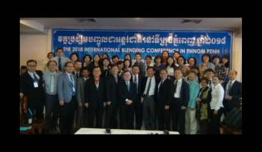
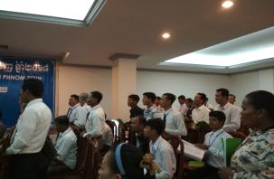
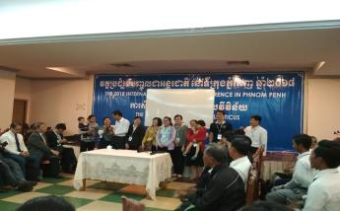
Conference 特會
Since 2007
every year many overseas saints have come to blend with the local saints
80 overseas had blending with 250 local saints in 2018
自從2007年
每年有許多從海外來的聖徒
與當地聖徒 2018年 80位從海外與 250位本地聖徒

Slide 21
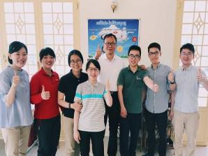
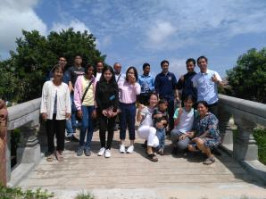
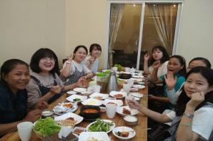
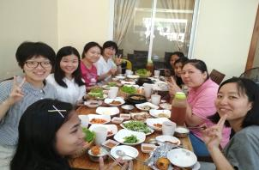
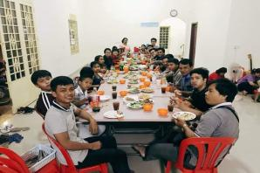
Blending 相調

Slide 22
6
Training 訓練
Training
Training
01
02
Responsible Brothers
負責弟兄
College Student
大專

Slide 23
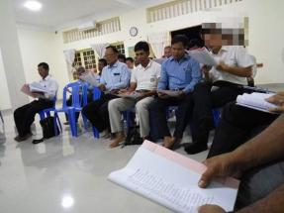
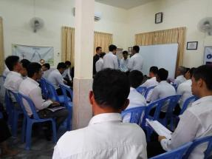
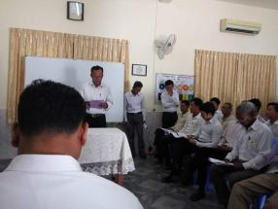
Responsible Brothers Training 負責弟兄訓練
Three times by overseas coworkers
藉著海外同工一年三次

Slide 24
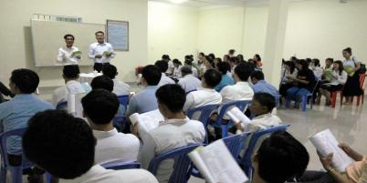
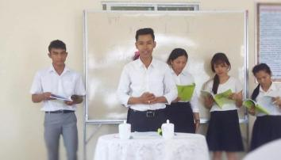
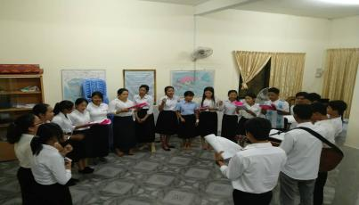
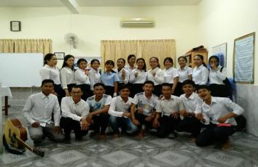
College Student Training 大專訓練

Slide 25
Calendar of Events 行事曆
Outlook 展望（2018.10 - 2019.10）
Date | Gospel/Traning/Conference/Blending/ Setting up Testimony
November11/1-19 2018 | Gospel move with FTTS trainees
November11/9-11 2018 | Responsible Brothers Training
January1/19--21 2019 | International Blending Conference
February1/29--2/8 2019 | Gospel with the saints from Taiwan
March3/8-9 2019 | Sisters' Training
April4/26--28 2019 | Responsible Brothers Training
May 5/11--13 2029 | College Student's Training
June6/1--2 2019 | Young People Conference
July7/12--13 2019 | Responsible Brothers Training

Slide 26
The statistics of Gospel, Home visitation, Small Group, District meeting 福家排區統計報表
Taking Phnom Penh and Siem Reap as an example weekly report 以金邊和暹粒為例週報表：
 | Number of saints | No. of saints going out for gospel | No. of saints visiting the new ones | No. of saints participating in small groups | No. of saints attending Lord’s Table | % of saints prophecy
Phnom Penh | 142 | 10 | 15 | 31 | 48 | 48%
Siem Reap | 114 | 10 | 6 | 16 | 36 | 58%

Slide 27
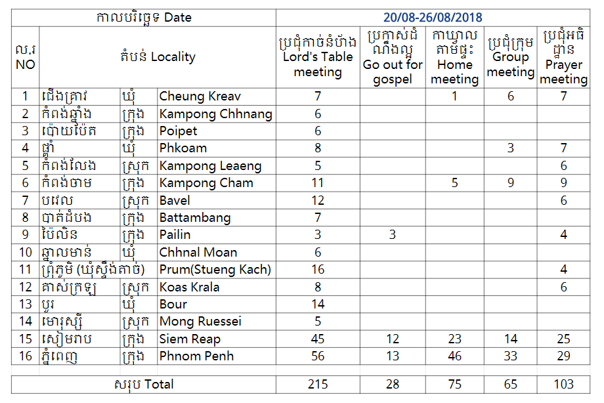
The statistics of all locality,
Taking August
20-26 as an example
各个地方的统计，
以8月20~26日为例

Slide 28

Praise the Lord! May the Lord bless His move in Cambodia!
讚美主！
願主祝福祂在柬埔寨的行動！

