Slide 1
Sanctifying Our Smartphone for Organic Shepherding

Slide 2
Ministry Excerpt
“Just as humans cannot live apart from a community, so Christians also cannot live apart from a “community,” the church. The word church is a translation of the Greek word ekklesia, which implies an assembly.”
“According to God's ordination, we cannot live apart from a community as humans, and we cannot stay away from the church as Christians. Once we are in a community, relationships are developed spontaneously.”

Slide 3
In human society in general, such contact produces more evil things than good things. A believer, however, has a relationship with another “community,” the church. These two kinds of relationships require two different kinds of contact.
A person who serves the Lord must have a proper relationship and proper contact with those both in society and in the church.
(The Vision, Living and Work of the Lord's Serving Ones, Chapter 16)

Slide 4
U.S. smartphone owners spend about 5 hours a day on their devices
Source: http://flurrymobile.tumblr.com/post/157921590345/us-consumers-time-spent-on-mobile-crosses-5

Slide 5
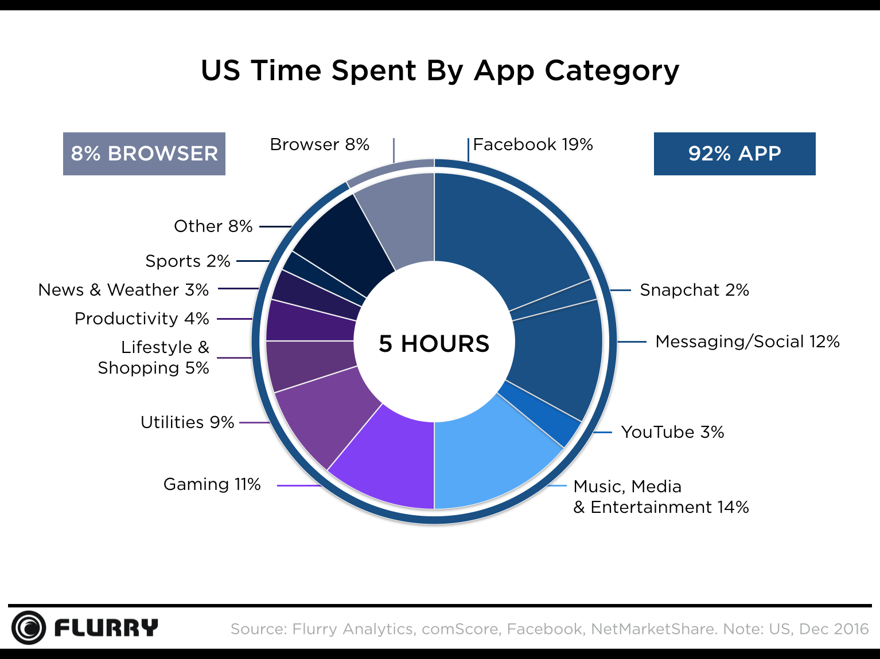
U.S. smartphone owners spend about 5 hours a day on their devices
Source: http://flurrymobile.tumblr.com/post/157921590345/us-consumers-time-spent-on-mobile-crosses-5

Slide 6
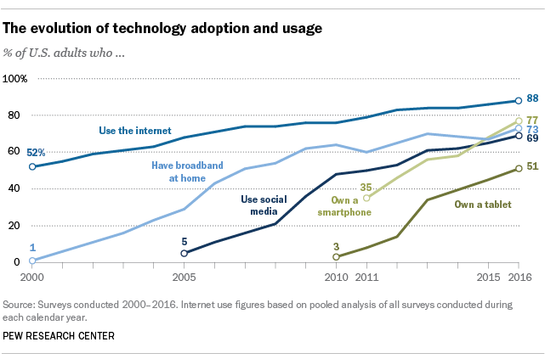
Roughly three-quarters of Americans (77%) now own a smartphone
Source: http://www.pewresearch.org/fact-tank/2017/01/12/evolution-of-technology/

Slide 7
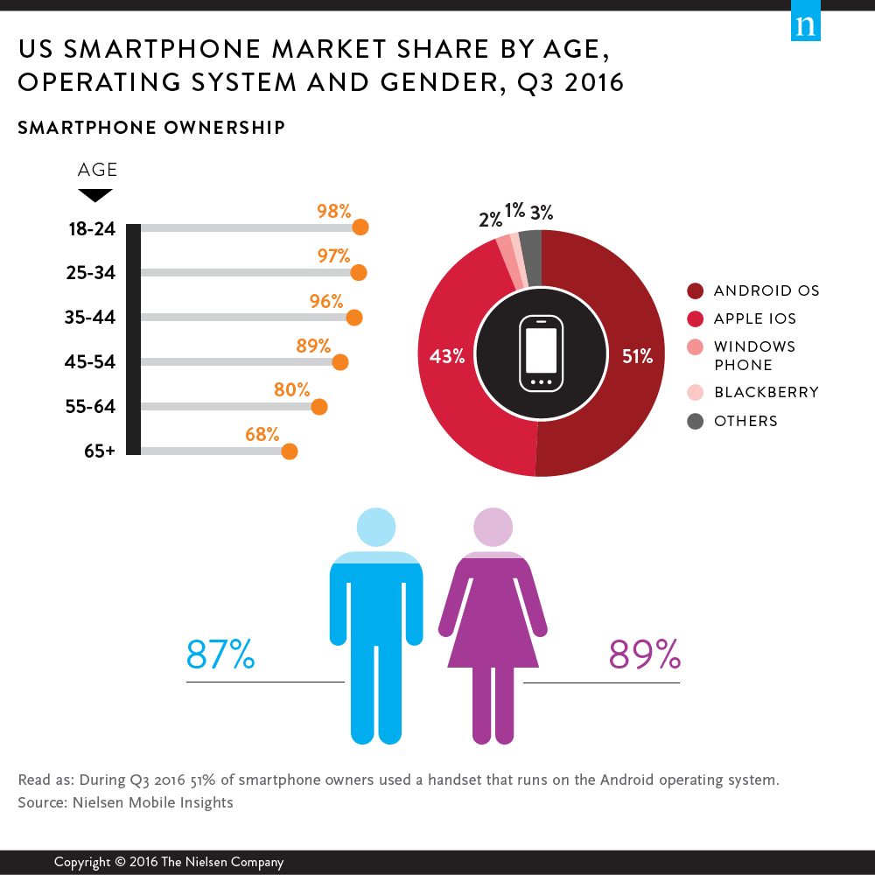
Millennials Are Top Smartphone Users
Source: http://www.nielsen.com/us/en/insights/news/2016/millennials-are-top-smartphone-users.html

Slide 8
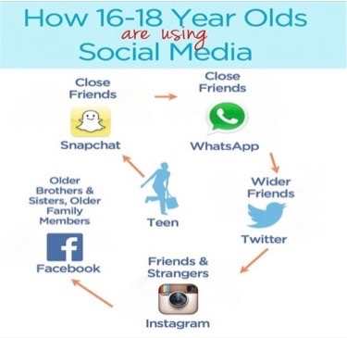
Circle of Friends: Community & Relationships
Research has found that older teens use different social channels to connect with different people.
*From 2013 survey taken in the U.K.
Source: http://www.adweek.com/digital/social-teens/

Slide 9
Negative Effect of Smartphone on Teenagers
Psychologically, today’s teenagers are more vulnerable than Millennials were:
Rates of teen depression and suicide have skyrocketed since 2011. Much of this deterioration can be traced to their phones.
Source: https://www.theatlantic.com/magazine/archive/2017/09/has-the-smartphone-destroyed-a-generation/534198/

Slide 10
The Smartphone Generation:
A Statistical Portrait
Source: https://www.theatlantic.com/magazine/archive/2017/09/has-the-smartphone-destroyed-a-generation/534198/

Slide 11
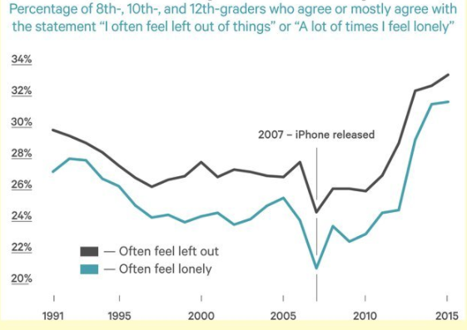
More Likely to Feel Lonely
Source: https://www.theatlantic.com/magazine/archive/2017/09/has-the-smartphone-destroyed-a-generation/534198/

Slide 12
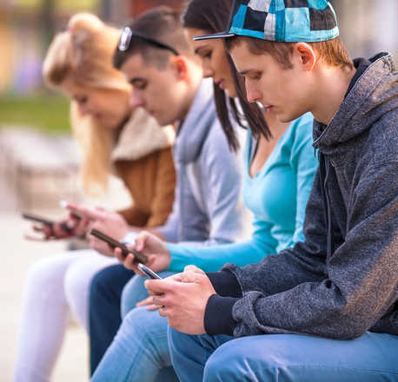
Your Smartphone is Changing the Human Race in Surprising Ways
The Way We Interact
The Way We Communicate
The Way We Learn

Slide 13
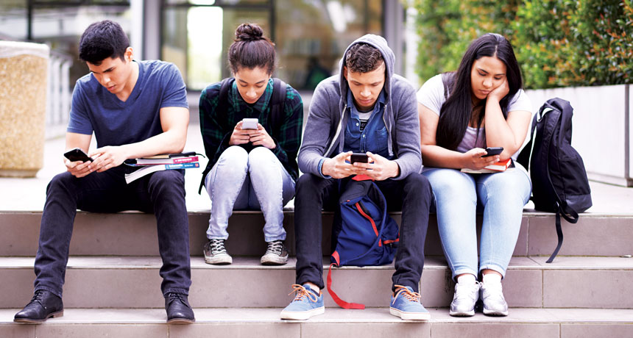
The Way We Interact
Technology is
Rewriting the Rulebook
for Human Interaction
People are trading off time interacting with each other for time spent "screen skating”
This creates an emotional and psychological sense of detachment at the subconscious or unconscious level.
We need to reclaim face-to-face conversation.
Source: https://phys.org/news/2015-03-technology-rewriting-rulebook-human-interaction.html#jCp

Slide 14
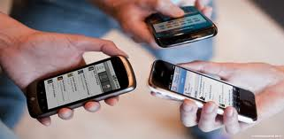
The Way We Communicate
Technology is
Expanding Our Worldviews
and Social Circles
We can communicate faster and more cost-effectively.
We have access to more information.
We have more choices of how to communicate.
A 2011 survey by Pew Research suggests that people who communicate using social media and mobile phones have more close friends than those who don’t.
Source: http://www.pewinternet.org/2013/05/21/teens-social-media-and-privacy/

Slide 15
The Way We Learn
Our digital devices have become a memory partner.
It has become much harder to practice attentive types of thinking.
Instant messaging support for teaching and learning in higher education
Source: https://www.nbcnews.com/storyline/the-big-questions/your-smartphone-may-actually-be-changing-human-race-n743866

Slide 16
Instant Messaging Support for Teaching and Learning in Higher Education
Bite-sized materials and teacher-students interaction via WhatsApp supplement the traditional classroom instructions.
Students convey positive perception and acceptance toward this application of WhatsApp.
Source: http://www.sciencedirect.com/science/article/pii/S1096751616300343

Slide 17
Our Suggestion --- Not Social Media But Instant Messenger (IM)
What is Social media?
Social media is a broad term, that describes how people communicate on APPs or websites like Facebook, Twitter, Instagram, snapchat and others.
These APPs or websites tend to be more open and accessible to the general public.

Slide 18
What is Instant Messenger?
Instant messenger is a specific term, that describes how people communicate on APPS like, WhastAPP, LINE, WeChat, FB messenger and others.
You can instantly communicate with anyone anywhere in the world.
Communication tends to be more closed and restricted to a close circle of family or friends.

Slide 19
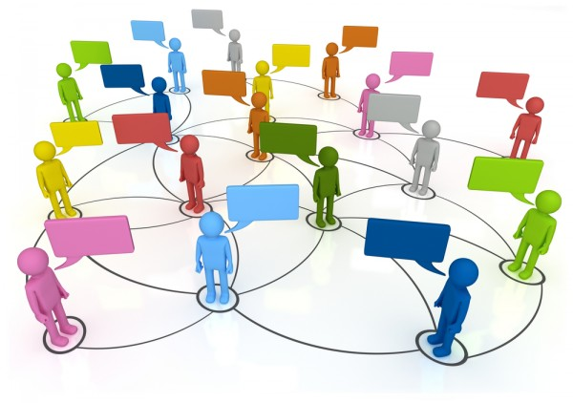
Benefits of Instant Messenger (IM)
Sanctified use:
The side effects can be minimized, (restricted to a close circle ).
At the same time, its spiritual benefits can be maximized in the way of...
(Just like newly baptized ones are always encouraged to witness and preach the gospel to their friends face-to-face.)
Witnessing
Gospel Preaching

Slide 20
Three Levels of Communication
Face-to-face
Mobile phone
Instant Messenger
(IM)
Before mobile phones
Mobile phone use
(voice/text)
Smart phone
(voice messaging/text)

Slide 21
Communication |  | Approach | Material
Face-to-face | Traditional Way | Talk | Book/booklet
Telephone | mobile phone use | Talk/Text | Digital books/booklets
Instant Messenger (IM) | Smartphone communication | Voice messaging /Text | Digital booklet, multimedia

Slide 22
Effective Mode of Communication
3 Levels of communication, combined in a flexible, effective way
Face-to-face
Mobile phone
Smart phone
Voice
Text/Voice
Text/Voice messaging
Like gears 1,2, 3 used in a car

Slide 23
“Neither present your members as weapons of unrighteousness to sin, but present yourselves to God as alive from the dead, and your members as weapons of righteousness to God.”
Romans 6:13
“…so now present our members as slaves to righteousness unto sanctification.”
Romans 6:19b
Note: Smartphones have become an extended member of our body.

